Slide 1
Brain And Culture; Some Important Inclusions
The Centre for History of Philosophy and Comparative Studies
The Institute of Philosophy of the National Academy of Sciences of Belarus
Valery Yevarouski E-mail: walewr@gmail.com
Vilnius 2019

Slide 2
Brain Reward System

Slide 3
Terminology
Reinforcement -- the action of strengthening or encouraging something
.

Slide 4
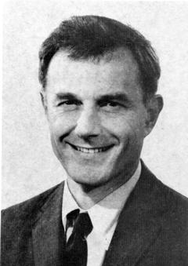
How The Story Began
JAMES OLDS
May 30, 1922–August 21, 1976
Considered as discoverer of the "reward" system in the brain
Jacobsen and Torkildsen replicated work in human
Olds, James, and Peter Milner. 1954. “Positive reinforcement produced by electrical stimulation of septal area and other regions of rat brain.” Journal of Comparative and Physiological Psychology 47(6):419–27
Notes:
The brain’s reward circuitry was first discovered by Olds and Milner [6] at McGill University in the early 1950s. They found that animals would repeatedly return to an area of the laboratory in which they had received mild electrical stimulation of subcortical structures anatomically associated with the medial forebrain bundle. Subsequently, they found that animals would avidly perform tasks (e.g. depressing wall- mounted levers in their test chambers) in order to receive such brain stimulation.
This system originates in the anterior bed nuclei of the medial forebrain bundle (an array of deep subcortical limbic loci anterior to the hypothalamus and preoptic area), descends to the ventral tegmental area of the midbrain via the medial forebrain bundle, and then ascends via the medial forebrain bundle to a select group of forebrain limbic loci including the nucleus accumbens, olfactory tubercle and frontal cortex. Wise and Bozarth [13] were the first to realize that this assortment of brain loci and tracts constituted a neural circuit containing three synaptically connected, in- series neuronal elements: a descending link running from the anterior bed nuclei of the medial forebrain bundle to the ventral tegmental area, an ascending link running from the ventral tegmental area to the nucleus accumbens, and a further ascending link running from the nucleus accumbens to the ventral pallidum. The first link is the descending myelinated fiber tract first identified by Gallistel et al. [12], of unknown neurotransmitter type, although very recent evidence raises, by inference, the possibility that glutamate in the ventral tegmental area might play a role [14

Slide 5
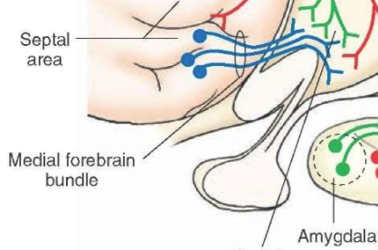
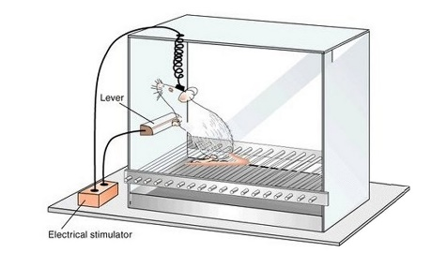
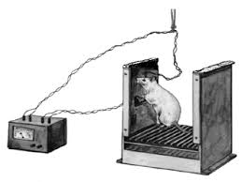
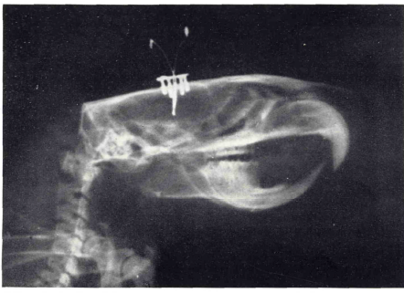
Electrode Stimulation
Mild electrical stimulation of subcortical structures associated with the medial forebrain bundle
Animals would avidly perform tasks in order to receive such brain stimulation
In the aftermath of this discovery of the phenomenon of brain stimulation reward
Gardner, Eliot L. 2011. “Addiction and Brain Reward and Antireward Pathways.” Advances in psychosomatic medicine 30:22
Notes:
Electrical brain stimulation reward is remarkable for the intensity of the reward and reinforcement produced [1]. When the stimulating electrode is properly on target within the ventral tegmental area, medial forebrain bundle or nucleus accumbens, laboratory animals will volitionally self- stimulate those areas at maximal rates. They will, tellingly, ignore readily available food, water, toys and sexually receptive animals of the opposite sex in order to self- deliver the brain stimulation reward. They will also volitionally accept aversive and painful consequences in order to self- deliver the brain stimulation reward.

Slide 6
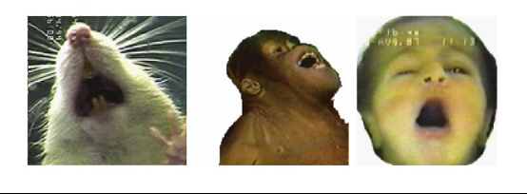
Animal vs Human
Reactions to Sweetness
‘Disgust’ Reactions to Bitterness
Olney, Jeffrey J., Shelley M. Warlow, Erin E. Naffziger, and Kent C. Berridge. 2018. “Current perspectives on incentive salience and applications to clinical disorders.” Current Opinion in Behavioral Sciences 22:59–69
Notes:
Addiction is defined as a syndrome in which drug use pervades all facets of the user’s life, even precipitating in the loss of social compatibility (e.g. loss of partner and friends, loss of job, crime...) [1]. It is obvious that addiction is a genuinely human phenomenon; and one that is therefore no reproducible within the unavoidable constraints imposed by the laboratory setting. However, some of the behavioural characteristics of this syndrome, such as resumption of drug seeking/drug consumption after a protracted abstinence (relapse), can be satisfactorily modelled in laboratory animals. For example, experimental procedures can be designed to be as simple as possible, thereby maximizing internal validity and thus reproducibility. Conversely, procedures can aim to be as holistic as possible, thereby favouring the possible relevance to human situations. Neither one of these two approaches is perfect; each has its respective drawbacks. Indeed, methods designed attending only to internal validity may finally exclude variables of relevance to understanding, explaining or predicting the phenomenon of interest. On the other hand, very complex procedures enhance the difficulty of arriving at conclusions and reduce the capability of both inferring causal relationships between variables and of establishing predictions.
This animal model has produced an impressive amount of information on brain mechanisms involved in addiction and on vulnerability factors in addiction. Recently, this model has been turned to the elucidation of incentive motivational factors in addiction, mechanisms underlying relapse to addiction and possible pharmacotherapeutic treatments for addiction.
I argue that animal models of voluntary drug intake—under nonoperant and operant conditions—and addiction models based on the Diagnostic and Statistical Manual of Mental Disorders are crucial and informative tools for the identification of pathological mechanisms, target identification, and drug development. These models provide excellent face validity, and it is assumed that the neurochemical and neuroanatomical substrates involved in drug-intake behavior are similar in laboratory rodents and humans. Consequently, animal models of drug consumption and addiction provide predictive validity.
Humans and laboratory animals, such as monkeys, rats, and mice, voluntarily take drugs by different routes of administration, be it orally or intravenously. If unlimited voluntary intravenous access to heroin or cocaine is provided, laboratory animals can easily overdose to death. Lethal overdosing also frequently happens in drug users. Mice and rats can also voluntarily drink large quantities of alcohol, which leads to strong intoxication. These characteristic features seen in drug-taking behavior in laboratory animals resemble drug-taking behavior in humans and suggests a high degree of face validity. How'ever, face validity is often a result of anthropomorphic interpretations of an animal’s behavior. If, however, behavioral features are evolutionarily de- veloped, real face validity is inferred. For example, behavioral fear responses are critical to most species for survival and developed over millions of years.

Slide 7
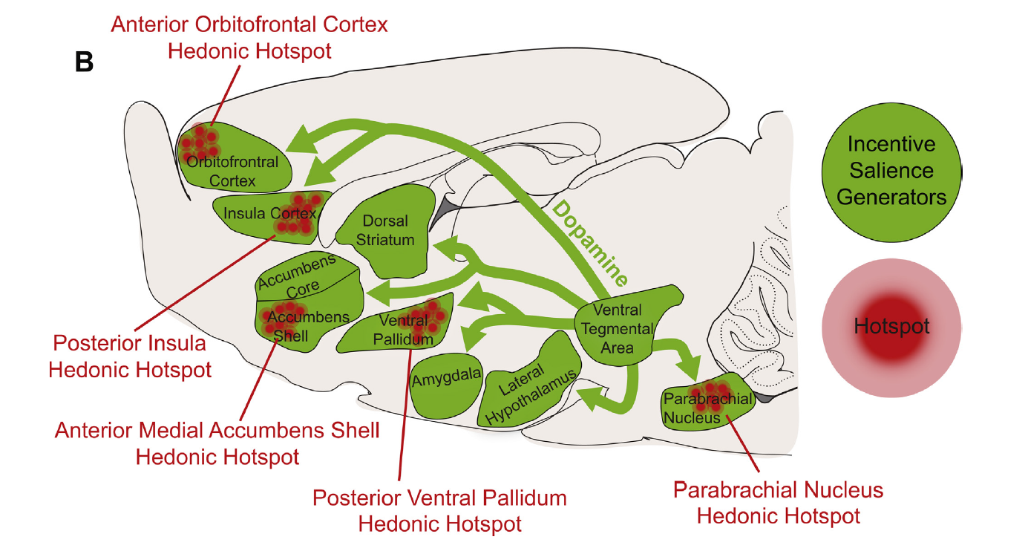
RAT REWARD SYSTEMS
Olney, Jeffrey J., Shelley M. Warlow, Erin E. Naffziger, and Kent C. Berridge. 2018. “Current perspectives on incentive salience and applications to clinical disorders.” Current Opinion in Behavioral Sciences 22:59–69
Notes:
Incentive Salience [ɪn'sentɪv] ['seɪlɪən(t)s]
The reward system is described neurobiologically with the help of chemical and physiological processes in the brain (Koob, Arends and Le Moal 2014; Koob and Kreek 2007). Dopamine (Berridge and Robinson 2003), serotonin (Higgins and Fletcher 2003) and other neurotransmitters which are referred to the biochemical analysis of the reward system do not associate with fanfares, prizes, and other means of human reward. Everybody feel pleasure often, but our knowledge of this feeling (as all others) is extremely limited.

Slide 8
Natural Reinforcement
Sweet
Sexual Temptation
Water
Hunting Meat
Reward-motivated Seeking Behaviors
Notes:
I might say something doubtful, but it seems so. In fact, both pleasure and disgust are not just reactions to signals from the world around us but also to the physiological and even chemical processes as such. The complex mechanism of dopamine release in the human brain is a natural process with physical, chemical and biological characteristics. However, no human approaches work in it. In other words, the sugar is not sweet. This characteristic cannot be applied to the reaction of our body to eating of sugar or to the combination of neurotransmitters making us find it sweet (Pecina, Berridge 2005). It is purely subjective estimation. However, we can go even further. The tastes can be divided into pleasant or geek. This division is a prompt to the body on what to do with food (Harington et al., 2016; Pandurangan, Hwang 2015). From this viewpoint, our actions can be estimated as beneficial, harmful and useless. Tire first ones should be kept, the
second ones should be avoided, and the third ones ought to be used to help the first ones with maximum efficiency. Thus, we get back to the reward system description. A person that believes in his or her unhappiness may simply think so. But we may say he or she lacks the internal potencies to stimulate the reward system properly (Volkow, Wise 2005).

Slide 9
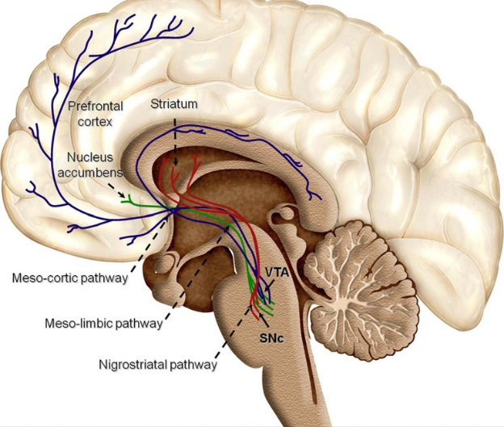
Reward Pathways Are Very Old
Surprisingly the brain structure that responsible for reward lays in the old areas of the brain and so is not strongly human
The areas of brain govern our biological reward system that appeared long before we (as species) had begun to exist. We can metaphorically describe the reward system as a trace of God in the human mind
These brain structures are referred to as reward pathways, which are very old from an evolutionary point of view and which presumably evolved to mediate an individual’s responses to natural rewards, such as food, sex, and social interaction
Arias-Carrión, Oscar, Maria Stamelou, Eric Murillo-Rodríguez, Manuel Menéndez-González, and Ernst Pöppel. 2010. “Dopaminergic Reward System: A Short Integrative Review.” International archives of medicine 3:24.
Notes:
These brain structures are referred to as reward pathways, which are very old from an evolutionary point of view and which presumably evolved to mediate an individual’s responses to natural rewards, such as food, sex, and social interaction. Drugs of abuse activate these reward pathways, in the absence of natural rewards, with a force and persistence not seen under normal conditions. Over time, repeated drug exposure causes adaptations in the brain’s reward pathways, which seem to have two major consequences. First, during periods of active drug use or shortly after ceasing drug intake, the ability of natural rewards to activate the reward pathways is diminished, and the individual experiences depressed motivation and mood. Taking more drug is the quickest, easiest way for a person with addiction to feel “normal” again. Second, drug use causes long-lasting memories related to the drug experience, such that even after prolonged periods of withdrawal (months, years), stressful events or exposure to the drug or to drug-associated cues can trigger intense craving, and in many cases relapse, in part by activating the brain’s reward pathways. Roughly half of the risk for addiction is genetic, although few specific genes that constitute this risk have to date been identified (6,7). A great deal of effort is aimed at identifying these specific genes and the mechanisms by which diverse nongenetic factors interact with the genes to influence the development of an addictive disorder.
It is accepted that human brain consists of two types of structures (Hofman 2014). There are new and old ones. The new structures are the direct consequence of the evolution of the homo sapience. The old segments of a human brain were inherited from progression of our biological predecessors like apes, reptiles or for example fishes. Surprisingly the brain structure that responsible for reward lays in the old areas of the brain and so is not strongly human. It is quite tricky: all human’s higher nervous activity, social achievements and losses can be ended with the processes in the depths of the brain. The areas of brain govern our biological reward system that appeared long before we (as species) had begun to exist. We can metaphorically describe the reward system as a trace of God in the human mind

Slide 10
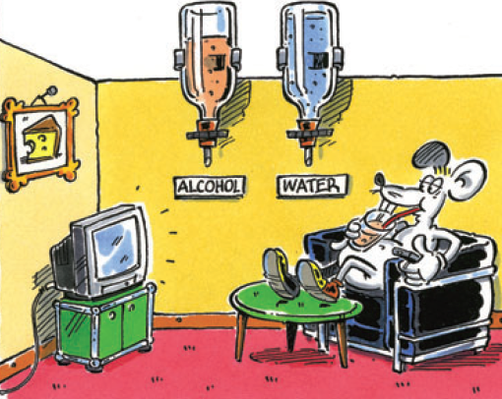
Animal Models
Laboratory animals volitionally self-administer ethanol , just as humans do. Furthermore, the rank order of appetitiveness in animals parallels the rank order of appetitiveness in humans.

Slide 11
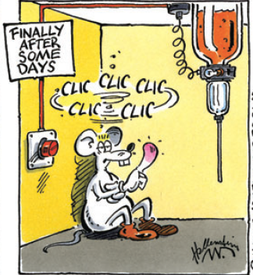
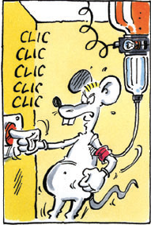
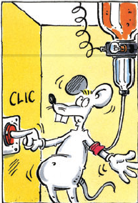
Animal Models
Mice and rats can also voluntarily drink large quantities of alcohol, which leads to strong intoxication
Some of the behavioral characteristics of addictions events, can be satisfactorily modelled in laboratory animals.
However, face validity is often a result of anthropomorphic interpretations of an animal’s behavior.
Sanchis-Segura, Carles, and Rainer Spanagel. 2006. “Behavioural Assessment of Drug Reinforcement and Addictive Features in Rodents: An Overview.” Addiction biology 11(1):2–38
Notes:
And fourth, the reward structure we talk about is not entirely human. Remember its characteristics as an old structure of a humanoid brain that we got from animals and other biological ancestors. In this respect, its functioning is implicit for the whole humanoid mind structure and is in some contradiction with the nature of human activity at same time.
Let us imagine what the reward system can be as a function of animal behavior that is not burdened by social meanings and customs. It will not be too bold and suppose that animal ability to plan does exist but at a very rudimentary level (Bekoffet al. 2002; Lurz 2011). Thus, if we could talk to a bat (a kind of resorting to Thomas Nagel’s parallel (1974)), we would fail in persuading it to do something to get a reward in, say, a year. My research of intellectual history reveals that humanity, at its social level of evolution, not the biological one, had a long journey of the enlargement of our time intervals. The continued development taught us to plan for years to come and not just to live this day. Of course, only the bat can give the best answer to how harmonic its reward system function is in respect to its activities (for instance, predicting hunting targets or choosing the right mating partner). And, what is also important, how precisely probable behavior errors are corrected.

Slide 12
Social reinforcement?

Slide 13
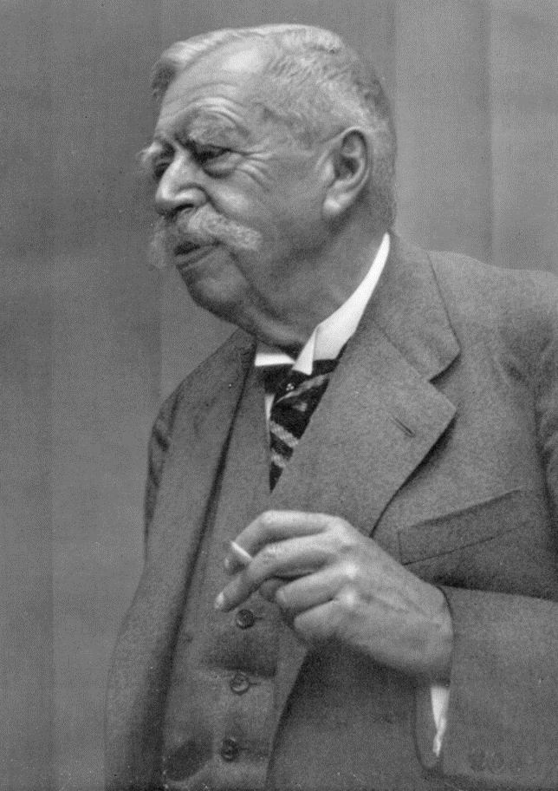
Worlds of Animals and Humans
Jakob von Uexküll
1864–1944
Nobody is a product of their environment but everybody is the master of one's Umwelt.
Uexküll, J. B., 1934. Streifzüge durch die Umwelten von Tieren und Menschen Ein Bilderbuch unsichtbarer Welten.
Notes:
Jakob v., A Foray into the Worlds of Animals and Humans [1934]: With a Theory of Meaning / Jakob Von Uexküll ; Translated by Joseph D. O'Neill ; Introduction by Dorion Sagan ; Afterword by Geoffrey Winthrop-Young. Vol. 12. 1st ed. Minneapolis, Minn.: University of Minnesota Press

Slide 14
Basic Worlds of Human
the Eigenwelt, the sphere of man in relation to himself
Umwelt -- the world of man in his biological environment
Mitwelt, man in personal relations with fellowmen
Umwelt
Eigenwelt
Brain
Mitwelt

Slide 15
Home-Garden-Street-Analogy
Eigenwelt
Umwelt
Mitwelt

Slide 16
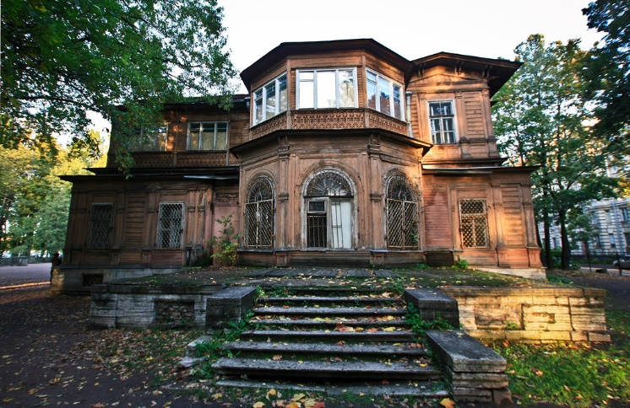

Slide 17
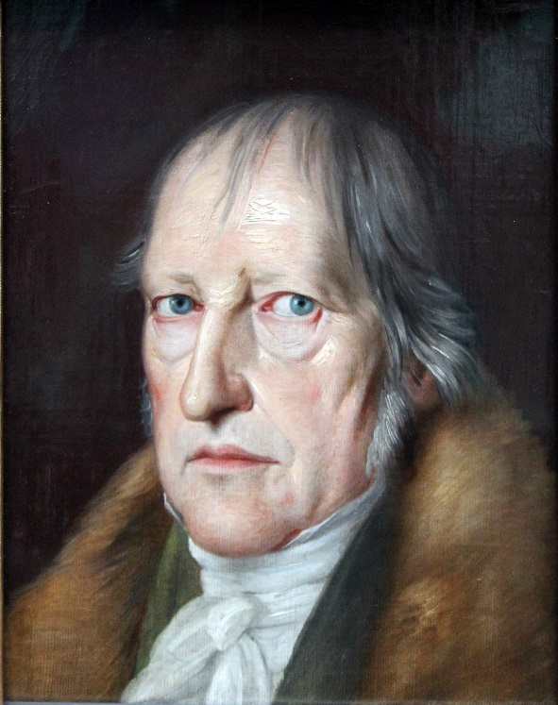
Phänomenologie des Geistes
Hegel, Georg W. F. Phenomenology of spirit (1807)

Slide 18
Dienstes, Gehorsams und Bilden
Ohne die Zucht des Dienstes und Gehorsams bleibt die Furcht beim Formellen stehen und verbreitet sich nicht über die bewußte Wirklichkeit des Daseins. Ohne das Bilden bleibt die Furcht innerlich und stumm, und das Bewußtsein wird nicht für es selbst.

Slide 19
Discipline, Obedience, Self-Cultivation
….
Without the discipline of service and obedience, fear remains at the formal stage, and does not extend to the known real world of existence. Without the formative activity, fear remains inward and mute, and consciousness does not become explicitly for itself …

Slide 20
Ideal Self
Umwelt
Eigenwelt
Brain
Mitwelt
Mitwelt
Eigenwelt
Brain

Slide 21
Brain And Culture; Some Important Inclusions
The Centre for History of Philosophy and Comparative Studies
The Institute of Philosophy of the National Academy of Sciences of Belarus
Valery Yevarouski E-mail: walewr@gmail.com
Vilnius 2019

