Slide 1

Social Capital effects on Migration in a Modern Global Society
Liudas Panavas¹ and Darius Plikynas²
¹ University of South Carolina
² Vilnius university
Corresponding author: lpanavas@email.sc.edu

Slide 2
Motivation (1)
  Average annual rate of change in the number of international migrants by country or area of destination, 2000 to 2017 (Source: United Nations (2017a))

Slide 3
Motivation (2)
For instance:
  Since 1990 the number of residents living in Lithuania has dropped by 883 thousand people, which constitutes about 24 percent of the entire population. Out of the aforementioned number, 177 thousand can be referred to natural causes (birth/death rate), but the vast majority (707 thousand) is due to emigration. Even though in and of itself emigration is not a negative phenomenon, the immense emigration and unproportionally low immigration rates present an array of challenges in Lithuania and other countries:
  the demographic structure is changing (population ageing),
  the country is starting to lack workforce,
  brain drain is occurring,
  social tensions are growing, etc.

Slide 4
Background
Social Factors
- Social networks
- Marital status
- Self realization
Economic Factors
- Higher wages
-Job opportunities
-Better facilities
Migration Flow
Political Factors
- Political unrest
- Corruption
Studies of migration flow are becoming more important as world becomes a global society
Different types – International, rural to urban, inter-regional
Multitude of factors push and pull migrants

Slide 5



Why study migration flow
  Allow politicians to allocate resources and create policies based on amount of people living in the country
Brain Drain
National Identity
Social Welfare

Slide 6
Modelling Migration Flow
Challenges | Solutions
Even the best data is often unreliable and under represents the real amount of migrants Many different motivations that cause migration Lack of a uniform definitions for migration Many competing theories to explain migration | Decision theories can help alleviate inconsistent or inadequate data and move beyond extrapolation Data gathering is improving on migration flow, especially in Europe Models based in theory can be validated using data

Slide 7
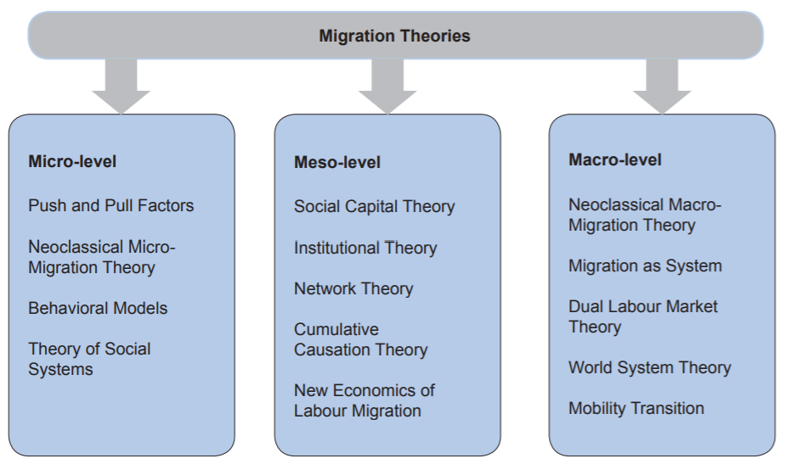
Competing Theories of Migration Modelling

Slide 8
Implement ABM system
Agent Based Model
Realistic modelling of social interaction and networks
Can go beyond economic reasons
Incorporate theories from multiple disciplines
Still in its infancy – room to grow and improve
Can incorporate empirical evidence and decision theory
Agent Based Modelling (ABM) can be effective way to model migration flow
There is a lot of room to grow and improve the ABM models

Slide 9
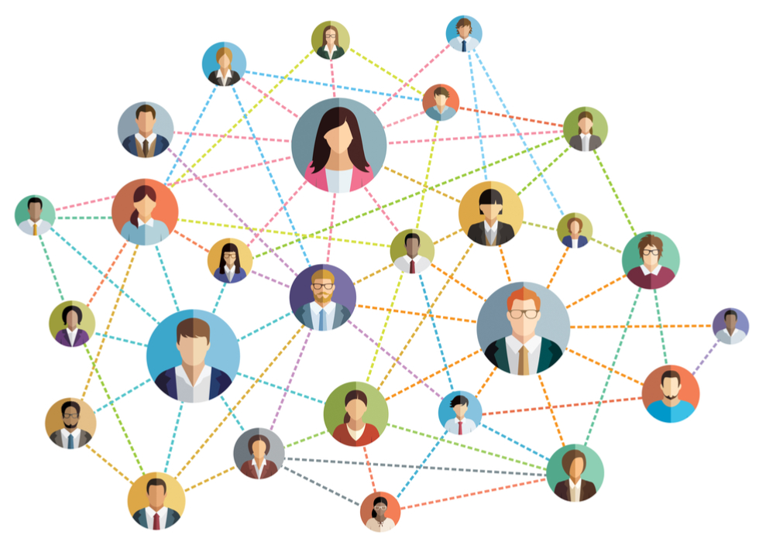

Research Gaps
Utilization of social capital
  Network capital and network utilization
  People utilize networks differently as they get older
Culture of emigration
  What causes a country to develop an outward flow of people
  Is there a threshold emigrant social networks must reach to create a culture of emigration

Slide 10
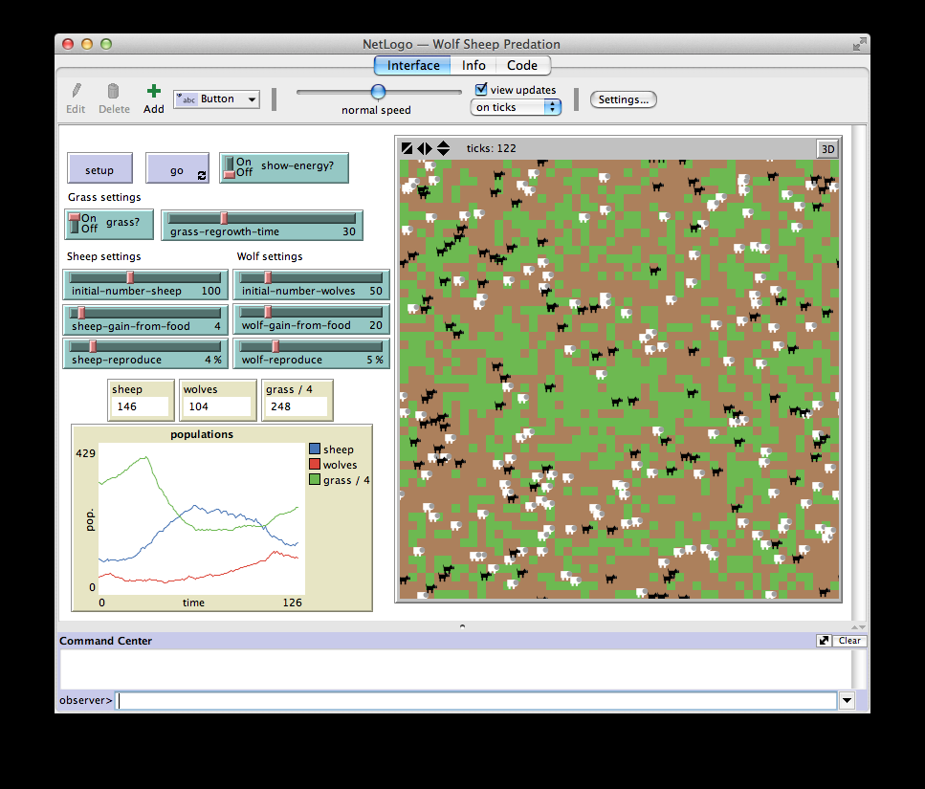
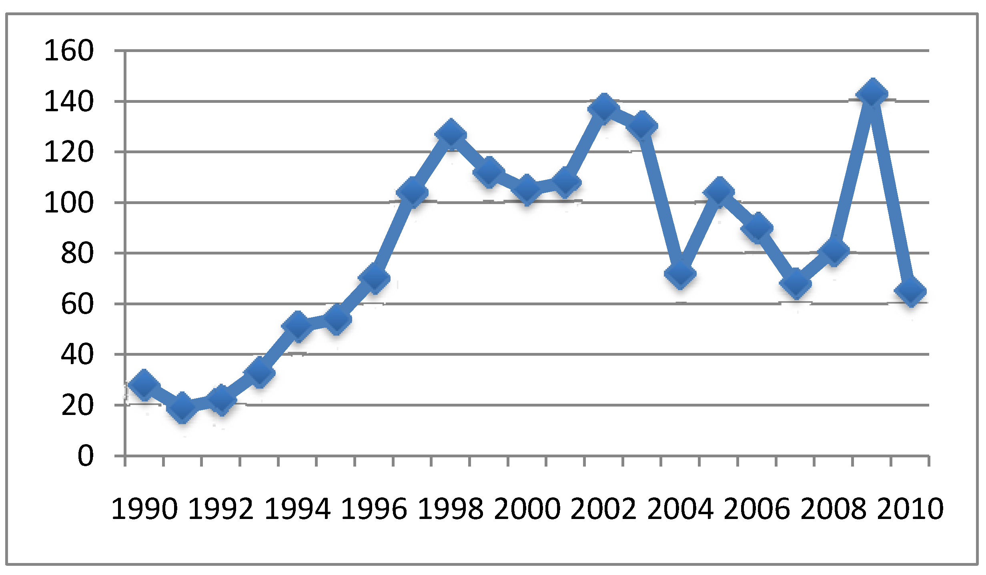

Research Gaps
What role should empirical data play and what role should decision theory play
What kind of metrics should be used to judge probability to emigrate
How do we best validate ABM systems
  Sensitivity analysis and validation should be more thoroughly conducted

Slide 11

Hypothesis
Once a person has enough emigrants in their social circle, they are significantly more likely to emigrate themselves
The longer one stays in a certain location the less likely they are to emigrate
The likelihood to emigrate strongly decreases with the age of a person

Slide 12
Model - Setup
Agents are programmed with certain traits
  Network probability– Agents likelihood to expand its links– decreases over time until death
  Emigration probability – Dictates likelihood to emigrate – Can change depending on interactions
  Emigration gene – emigrants – allowed to broadcast to others that they have emigrated
  Stationary gene – they do not move and are unaffected by emigrant broadcasting
  People in the middle – can move but cannot broadcast their movement

Slide 13

Model - Go
Interactions occur through broadcasting and local interactions
  Broadcasting – If an emigrant broadcasts and agent in extended social network has equivalent emigrant gene -> direct link is formed
  Direct interaction – agent chooses to interact based on network probability
    Neighborhood interaction – if the network probability is low, agent will interact with closer links – Emigration probability will decrease by random x (1- emigrant probability)
    Distance interaction – if network probability high agent will interact with agents in outer social circle – Emigration probability will increase by random x emigrant probability

Slide 14

Model - Go
Agent will ultimately move based on if their emigration probability and number of emigrant links exceeds a certain threshold
New agents are added at the rate old ones die
  Agents will die at the average age of the designated country
  New agents will be added with the same probabilities that the setup was created with

Slide 15
Are they an emigrant and wish to broadcast
Is there an agent with an emigrant probability equal to the broadcast level in the area
Yes
No
Yes
No
No new links created
Create new link
Agent chooses to interact based on network probability
By neighborhood
By distance
Yes
Agents emigrant probability changes by random percent of interaction with link.
By neighborhood decrease (1-prob)
By distance increase (prob)
If amount of emigrant links multiplied by emigrant probability exceeds threshold
No

Slide 16

Conclusions
Need more models that combine economic and social reasons for migration
Need models to understand who will migrate, when they will migrate, and why they migrate
Migration modelling is still in its infancy and there is much room for improvement

