Slide 1
Behaviour Patterns in Expert Recognition by Means of Structured Expert Judgment in Price Estimation.
Birutė Mikulskienė, Viktor Medvedev, Tomas Vedlūga, and Olga Navickienė
Mykolas Romeris University, Institute of Leadership, LITHUANIA
The Case Of Customized Furniture Manufacturing
MSBC 2019, September 18-20, 2019, Vilnius

Slide 2
Hello!
The value of customization
Problem: pricing at the early stage and expert based pricing
Methodology: case study/survey/case study
Findings: complexity management strategies

Slide 3
Values of customization
Both production company and customer gain additional value from customisation
Value for customer
Value for company
to obtain an individual product.
Customer is willing to pay more
Value for customer
Value for company
Customer engagement contributes directly to company success
to be engaged in the production of this product.
Value for customer
Add Contents Title
more interested in design, aesthetic, function of the product they purchase

Slide 4
Problem: customization
The furniture manufacturing sector of the Baltics is facing serious challenges:
the growing global competition for customized solutions.
New standards in the industry tend
to increase production costs,
extend manufacturing time
cause frequent errors in the product quality.
To maintain sustainability, companies need decision support instruments, allowing an immediate reaction to customized orders and proper evaluation of manufacturing procedures, costs and deadlines.

Slide 5
Problem: cost estimation
The actual costs of customized manufacturing are often difficult to estimate even when they have already been incurred while estimations of a competitive price are nearly impossible during the planning phase.
Uncertainties in planning and design considerably add to the cost estimation risk
New trends in extensive data research, triggering the need to possess a cost estimation system already at the early design stage
The task of cost and price estimation is primarily grounded upon the company’s capacity to recognize complexity, which is rapidly growing in the modern manufacturing sector.

Slide 6
Problem: experts
Complex decision making problems, as well as cost estimation problems, are often attributable to
absence,
insufficiency or
inaccuracy of available data.
Therefore, it is worth discussing a meaningful use of
expert knowledge to compensate the complexity of price calculation and foresee possible errors.

Slide 7
The goal
is to look into the cultural pattern of competence recognition within furniture industry with the purpose to adjust the structured expert judgement strategy as an instrument to validate expert input into the decision support tool for cost estimation.
The main question about methodological recommendation for expert selection for SEJ is analysed in the frame of broader sectorial picture, e.g.
(a) the pricing process, ICT usability and experts;
(b) the accuracy of pricing forecasts by experts. The broader context of research context has led to the choice of methods.

Slide 8
Furniture manufaturing in Lithuania
Recently, Lithuania’s furniture manufacturing sector has been rapidly growing.
1184 furniture manufacturers
Number of companies increased by 26 % during the last years.
The value added has doubled over the last decade.
More than 2/3 of production has been sold overseas to comprise 19% of the total Lithuania’s export.
Lithuania’s furniture export grew by 12.3% in the period from January to April, 2018 compared to the same period of 2017.

Slide 9
METHODOLOGY
Methods
Semi-structural interview
Survey.
Structural expert judgement
Sector: furniture
Topics for data collection
about the production
process
2. about engagement of
employees
3. about pricing methodology
Data
Extended interviews on different issues,
statistical data,
Probabilistic evaluation of expert knowledge
Time
from June, 2016 to March, 2018.
January to February 2019
Respondents
Furniture companies,
their employees (company leaders, managers, constructers and
production workers).
27 interviews
Two hours long.

Slide 10
Methods
Qualitative: Case study
The aim:
To find out what pricing stages are used by companies, how companies use expert knowledge to justify accuracy of the price.
the semi-structural interview method.
Two companies
26 interviews with a wide range of specialists within the company, including CEOs, managers, product developers, constructors.
A total of 174 pages of text and 905 coded notions
Quantitative: survey
The aim
To obtain quantitative data on the use of expert knowledge for price calculation understanding the cultural pattern of competence recognition
January to February 2019.
146 Lithuanian companies
A set of 35 questions included five major factors of the conceptual model
SEJ: case study
The aim
To test expert elicitation and expert ability to predict the price
10 employees (nominated as experts)
two generic quantitative dimensions of expert performance: calibration and information.
The calibration questionnaire: general information regarding to topic.
a list of several products was given for price estimation. Experts had to suggest possible prices on the basis of available data
An EXCALIBUR on the basis of Cooke's Classical Model

Slide 11
Methodology
The combination of the methods is expected to determine
whether there are specific behavioural trends that could limit application of SEJ in a furniture company.
Another objective to be achieved is
to investigate the possibility to adjust the SEJ strategy as an instrument to validate expert input into the decision support tool for cost estimation.

Slide 12
Findings: price calculation process
Each company uses different methods and methodologies of pricing.
However, there are some general trends in modelling furniture prices.
some companies set prices after preparatory design works
others rely upon immediately calculated average prices

Slide 13
Price calculation strategies: conflict between notion calculation and expertise
tangible and measurable product elements
intangible parameters that affect price calculation
entails tangible and measurable product elements, such as
product dimensions,
production time,
the number of produced units,
the used materials and
the market segment.
Words like
guesswork,
collaboration,
collective,
meetings,
intuition,
client
are typical here.
(Primarily predetermined by the influence of experts or experienced employees.)

Slide 14
The precise cost estimation process and ERP role

Slide 15
Findigns: survey
In Lithuanian furniture sector is dominated by small and medium-sized enterprises with
only a few large companies employing more than 800 people.
An interesting fact is that the majority of the companies have more than one employee responsible for pricing.
Most companies recognize this stage of manufacturing as important and sensitive to the quality. That is why companies see the need to have an “advisor” to assist in the calculations.
Not surprisingly, opinions of only few delegated specialists are taken into consideration during the price estimation stage.
Companies mostly trust employees who contribute to competitiveness – designers, constructors and product managers.
1) The simpler the structure of the company is (e.g. all employees directly accountable to the head of the company), the higher professional status is required for pricing (e.g. the director or the owner) (r_{s(144)} = –0.214, p = 0.01).
2) The higher position a company representative is holding, the more likely they are to take into account proposals of a senior employee (r_{s(144)} = 0.250, p = 0.02).
3) The higher the qualification of a specialist in charge of pricing is, the more likely their price estimates are to be taken into account (r_{s(144)} = 0.323, p = 0.07).

Slide 16
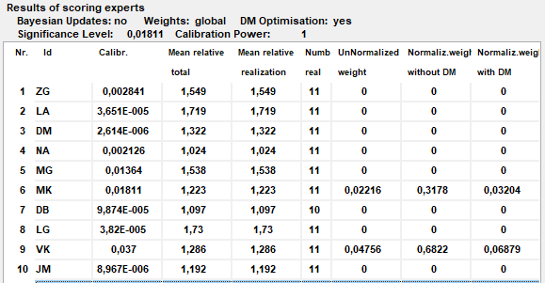
Findings: SEJ calibration
The results of the expert judgment based on Cooke’s classical model obtained by means of EXCALIBUR software show
only two experts out of ten were found suitable as experts for further cost estimation
Results of scoring experts (11 seed questions, equal weights).

Slide 17
Findings: SEJ information
For information, authentic data were provided by a Lithuanian furniture manufacturing company
The data included actual costs of the products.
the cost of materials,
the list and durations of the manufacturing procedures.
During the experiment, outputs from machine learning application were also used for cost estimation

Slide 18
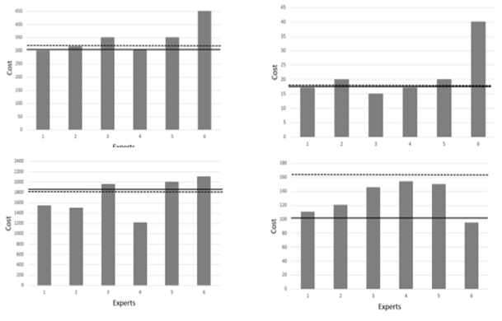
Some experts provide information very close to the actual prices
Fig. 3. Results of cost estimation for four products (straight line – the real cost of the product, dotted line – machine learning-based cost estimation)

Slide 19
Conclusions
The main intention of this study was to investigate
whether there are behavioural patterns within the particular sector
that limits smooth integration of different methods (machine learning and expert judgment) during operational decision (cost estimation) task.
Price estimation at the early design stage not only gives an opportunity for optimization of costs but also positively contributes to the development of customized production processes.
The survey in the principles that companies would expect from a Custom Order Price Estimation System has come up with strong arguments in favour of material-based pricing systems whereas systems based on ex-peer evaluations are subject to criticism.

Slide 20
Findings
Analysis of how companies rely on experts has revealed several trends.
Pricing in furniture industry is the prerogative of several professionals who are responsible for setting the right price.
This was confirmed by both the quantitative survey and a qualitative interview.
Selected experts demonstrate better results both in expert rating and price forecasting.
Recognition of the ability of top managers to predict prices has not been corroborated by SEJ results.
The fact might reflect both a limited distribution of responsibilities and a clear division of management responsibilities.

Slide 21
Conclusions
It was noticed that a well-composed group of experts could be a possible solution in assessing uncertain aspects of cost estimation.
The general requirement for the experts is that the group needs to have some specific knowledge necessary to understand the technical, organizational and financial side of the cost estimation.
Although the cultural model of the furniture sector would recommend a slightly different approach: the top executives and the best engineers in this sector are seen as experts.
Finally, a cultural pattern could express itself in corporate behaviour depending on the employee experience, education and skills.
Knowing the cultural boundaries of expert recognition and the fundamentals that make an impact on the rationality of decision making, one can adjust an operational research tool (for instance SEJ) according to sector specificity.

Slide 22
Acknowledgement
This project has received funding from European Regional Development Fund
(project No 01.2.2-LMT-K-718-01-0076)
under grant agreement with the Research Council of Lithuania (LMTLT).

Slide 23
THANKS!
Any questions?
You can find me at:
Birute.mikulskiene@mruni.eu

