Slide 1
Experimental Analysis Of Algebraic Modeling Languages For Social Behavior Modeling
International EURO Mini Conference, 2019
Modelling and Simulation of Social-Behavioural Phenomena in Creative Societies
Vaidas Jusevičius
Remigijus Paulavičius

Slide 2
CONTENT
Mathematical modeling and social behavior
Modeling systems and algebraic modeling languages (AML)
Characteristics of AMLs
Comparative analysis of AMLs
Performance benchmark
Pre-solving benchmark
Findings

Slide 3
Mathematical modeling and social behavior
Formalize the problem as a mathematical model using algebraic modeling language
social network analysis problems
social welfare maximization
Solve it using mathematical tools
e.g. PATH solver for mixed complementarity problems (MCP)
Requires knowledge of AMLs
Notes:
One of the ways to model social behavior is to formalize the problem as a mathematical model (e.g., social network analysis problems [1, 2]) using algebraic modeling language (AML) and attempt to solve it using mathematical tools (see [3], and references therein). However, this requires a researcher to be skilled in defining the problem using the terms of some AML. Moreoever, choosing an AML is not that trivial, since nowadays multiple competing AMLs exist.
René, A. O. N., Domoto, E., Ichifuji, Y., & Okuhara, K. (2015). A Social Network Analysis Based on Linear Programming-Shapley Value Approach for Information Mapping. In International Conference on Multidisciplinary Social Networks Research
In this work, we give particular attention to cooperative game theory (CGT) techniques. Precisely, we use an alternative equivalent Shapley value [9] model based on linear progarmming (LP) approach [4] to solve the problem of information sharing among the players. LP solver.
distribution (among the players) of a total surplus generated by the coalition of all players. The Shapley value is characterized by a collection of desirable properties. Hart (1989) provides a survey of the subject.^{[3][4]}
The setup is as follows: a coalition of players cooperates, and obtains a certain overall gain from that cooperation. Since some players may contribute more to the coalition than others or may possess different bargaining power (for example threatening to destroy the whole surplus), what final distribution of generated surplus among the players should arise in any particular game? Or phrased differently: how important is each player to the overall cooperation, and what payoff can he or she reasonably expect? The Shapley value provides one possible answer to this question.
PATH solver, a generalization of Newton's method, for finding a solution. While the modeling format is applicable in many disciplines, we draw the examples in this paper from an economic backgroun
Gabriel, S. A., Conejo, A. J., Fuller, J. D., Hobbs, B. F., & Ruiz, C. (2012). Complementarity Modelling in Energy Markets
Social welfare maximisation. Storage increases social welfare at the expense of producers, and smoothens prices (Schill and Kemfert, 2011) Costs of storage would exceed the social welfare gains, and storage modestly increases CO2 emissions (Lueken and Apt, 2014)

Slide 4
Research goals
Identify and compare the most important characteristics of modeling systems and algebraic modeling languages
Create a test model library for conducting practical experiments
Evaluate performance and pre-solving characteristics of selected modeling systems

Slide 5
Modeling systems
Algebraic modeling language
Bridges gap between model formulation and solution technique
Allows to be efficient in describing problems to be solved
Environment
AIMMS
AMPL
GAMS
Pyomo
Solvers and tools
Gurobi
BARON
GAMS Convert
Notes:
Algebraic model-
ing languages (AMLs), being a type of declarative optimization modeling languages,
bridge the gap between model formulation and the proper solution technique
Al-
gebraic modeling languages store the knowledge about a model, define the problem
but usually do not specify how to solve it.
The similarity of the model written in an algebraic modeling language to the mathematical formulation of a problem is an essential aspect which distinguishes algebraic modeling languages from other types of modeling languages, like object-oriented (e.g., \texttt{OptimJ}), solver specific (e.g., \texttt{LINGO}), general purpose (e.g., \texttt{TOMLAB}) modeling languages.
This algebraic design approach al-
lows practitioners without specific programming or modeling knowledge to be efficient
in describing problems to be solved.
It is also important to note that the algebraic modeling language is then responsible
for creating a problem instance that a solution algorithm can work on [18]
he selection was based on language recognition in the scientific community
and its usage popularity. The winners of 2012 INFORMS Impact Prize [16], a prize
awarded to the originators of the five most important algebraic modeling languages
were considered. Also, the popularity of an AML based on NEOS Server [23], a free
internet-based service for solving the numerical optimization problem, input statistics
were taken into consideration. Finally, an emerging open-source alternative
Pyomo
was
added to the list, since it might be attractive for situations where budgets are tight or
where the greatest degree of flexibility is required such as when new or customized
algorithmic ideas are being investigated [7].

Slide 6
Characteristics of AMLs
Problems are represented in a declarative way
There is a clear separation between problem definition and the solution process
There is a clear separation between the problem structure and its data
It is possible to describe non-linear models
Notes:
s they allowed separating model formulation from the implemen-
tation details [18] while keeping notation close to the mathematical formulation of the
problem [8]. Since the data appears to be more volatile than the problem structure,
most modeling languages designers insist on data and model structure being sepa-
rated [15]. Therefore, the central idea in modern algebraic modeling languages is the
differentiation between abstract models and concrete problem instances [14]. A specific
model instance is generated from an abstract model using data. This way, model and
data together specify a particular instance of an optimization problem for which a so-
lution can be sough
the support for mathematical expressions and operations needed for describing non-
linear models is considered as an important feature of an AML
All of the reviewed modeling languages belong to the AML family and are represented
in a declarative way. Furthermore, since all of them are part of the overall modeling
system, a clear separation between problem definition and the solution process in the
context of the modeling system exists. The separation between the problem structure
and it’s data is supported in all of the reviewed languages. It should be noted that
Pyomo
and
GAMS
also allow initiating data structures during their declaration while
AIMMS
and
AMPL
only support it as a separate step in the model instance building
process. However, while it might be convenient for building a simple model, we do not
consider the lack of direct data structure initiation as an advantage since, in real-world
cases, it is rarely needed. Therefore, we can conclude that all of the reviewed languages
fulfill the basic characteristics of a modern algebraic modeling language as defined in
the previous Section 2.

Slide 7
“AIMMS, AMPL, GAMS and Pyomo fulfill the basic characteristics of a modern algebraic modeling language”
Notes:
All of the reviewed modeling languages belong to the AML family and are represented
in a declarative way. Furthermore, since all of them are part of the overall modeling
system, a clear separation between problem definition and the solution process in the
context of the modeling system exists. The separation between the problem structure
and it’s data is supported in all of the reviewed languages. It should be noted that
Pyomo
and
GAMS
also allow initiating data structures during their declaration while
AIMMS
and
AMPL
only support it as a separate step in the model instance building
process. However, while it might be convenient for building a simple model, we do not
consider the lack of direct data structure initiation as an advantage since, in real-world
cases, it is rarely needed.

Slide 8
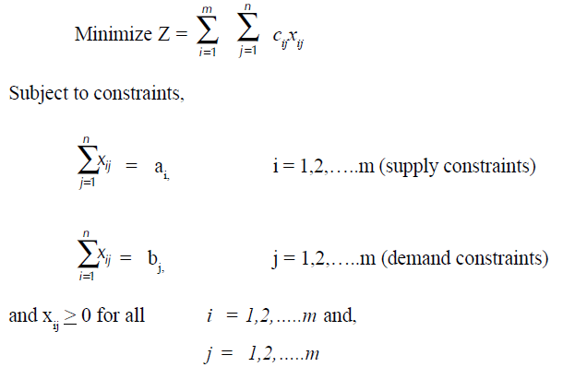
Comparative analysis of AMLs
Model size in bytes
Model size in number of code lines
Model size in number of language primitives used
Basic model instance creation time.

Slide 9
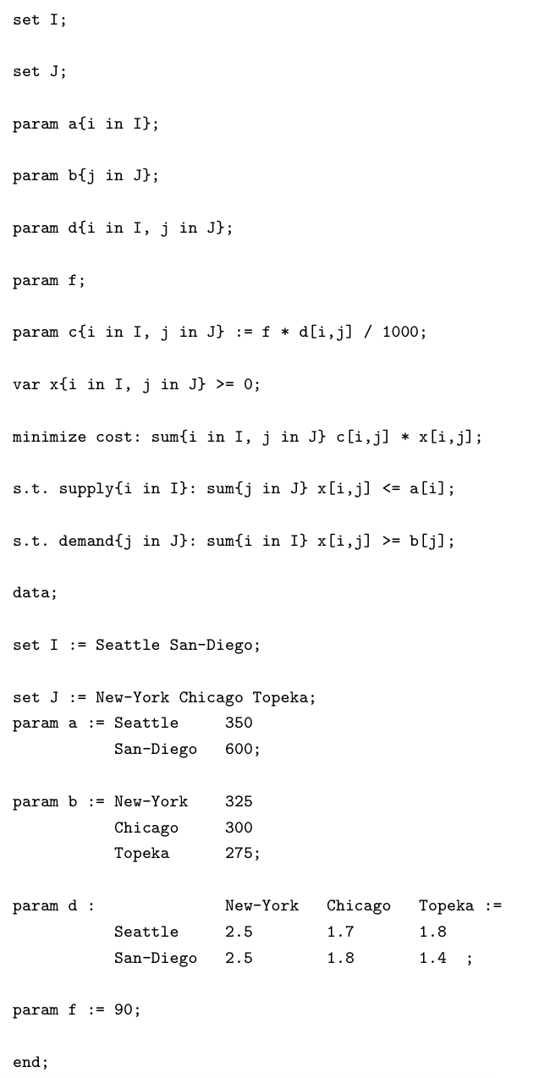
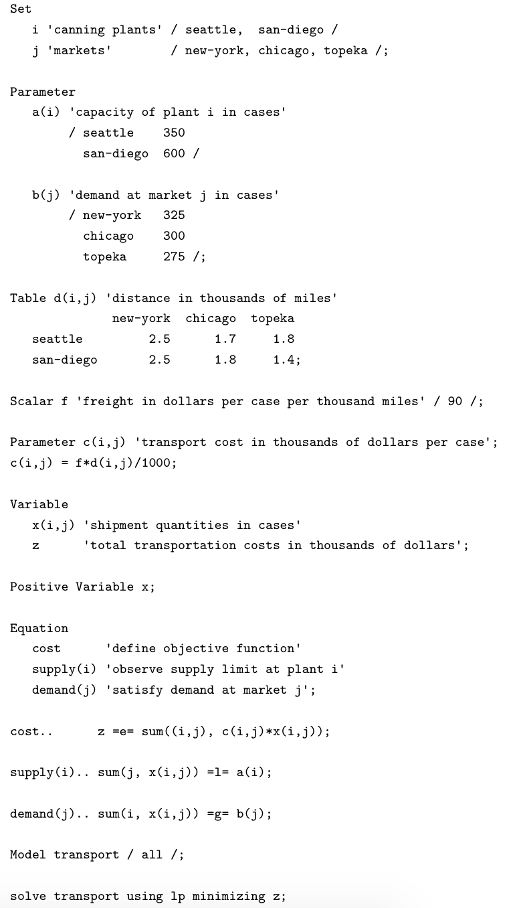
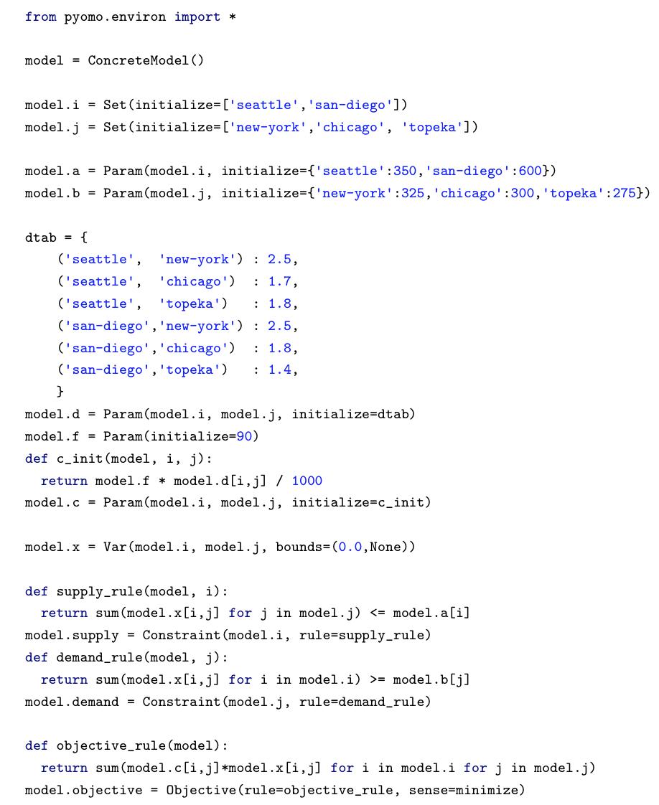
Transportation problem
AMPL
GAMS
Pyomo

Slide 10
Characteristics
Characteristics of model features
 | AIMMS | AMPL | GAMS | Pyomo
Size in bytes | 2229 | 683 | 652 | 1207
Lines of code | 68 | 24 | 31 | 28
Primitives used | 9 | 5 | 8 | 6
Characteristics of model instances
 | AMPL | GAMS | Pyomo
Constraints | 6 | 6 | 6
Non zero elements | 13 | 19 | 13
Variables | 7 | 7 | 7

Slide 11
Model instance creation time
Load model instance from a problem definition written in the native AML
Export model instance to MPS format
Measure total execution time
 | AMPL | GAMS | Pyomo
1 run | 30 ms | 170 ms | 720 ms
10 runs | 220 ms | 1730 ms | 7280 ms
100 runs | 2130 ms | 16490 ms | 79600 ms

Slide 12
AMLs testing library
Reference - GAMS Model Library
Scripts and instructions available at:
https://github.com/vaidasj/alg-mod-rev
AMLs: AMPL, GAMS, Pyomo
Generated using GAMS Convert tool
ID | Model | Type | Description | Eq | Vars | Vars Disc | Non zero | Non zero NL
1 | trnsport | LP | A Transportation Problem | 6 | 7 | 0 | 19 | 0
2 | blend | LP | Blending Problem I | 4 | 10 | 0 | 37 | 0
3 | prodmix | LP | A Production Mix Problem | 3 | 5 | 0 | 13 | 0
Notes:
The automated shell script \texttt{gamslib-convert.sh} availble in the \texttt{tools} directory of our GitHub repository~\cite{juseviciusGithub} was created to generate AMLs testing library. The script uses \texttt{GAMS Convert tool v.25}~\cite{gamsConvert} to convert model in \texttt{GAMS} proprietary format to a scalar model in the \texttt{AMPL}, \texttt{GAMS} and \texttt{Pyomo} formats. Characteristics of a sample problem models (number of equations, variables, discrete variables, non-zero elements, non-zero nonlinear elements) are automatically extracted and noted. Sample problems are also grouped based on optimization problem types
At the time of writing, there were 423 models in the GAMS Model Library.
Out of them, we eliminated 66 models which are using \texttt{GAMS} proprietary modeling techniques (e.g., \texttt{MPSGE}, \texttt{BCH Facility}), 20 using general-purpose programming languages features (e.g. cycles), four models tightly coupled to \texttt{CPLEX} and \texttt{DECIS} solvers.
We feel it is important to note that 35 models failed to be loaded by a fully licensed \texttt{GAMS Convert} tool due to execution or compilation errors. Thus meaning some models in the GAMS Library are not compatible with \texttt{GAMS} modeling system itself.
While performing the model instance creation benchmark, we have identified that 12 \texttt{AMPL} models and 29 \texttt{Pyomo} models generated by \texttt{GAMS Convert} tool had errors in them.
Most of the \texttt{Pyomo} errors were caused by an incorrect \texttt{GAMS Convert} tool behavior where the definition of the \texttt{Suffix} primitive uses \texttt{AMPL} but not \texttt{Pyomo} semantics. Example of what \texttt{GAMS Convert} generates and the correct \texttt{Pyomo} syntax can be seen in~\Cref{listing:pyomoerror}.

Slide 13
Performance benchmark
Determine time needed to create model instance for each model in testing library
Scripts and instructions available at:
https://github.com/vaidasj/alg-mod-rev
Methodology:
Load model instance
Export to format supported by the solver
Measure total time
Notes:
We have chosen to exclude sample problems which had conversion errors from the
benchmark (more information about them in Appendix A), meaning only the mod-
els which were successfully processed by all modeling systems were compared. This
reduced the scope of our benchmark to 269 models.

Slide 14
Benchmark (1)
Notes:
We can see the trend exhibited in the transportation problem model benchmark persists.
\texttt{AMPL} is still a definite top performer while \texttt{Pyomo} performs the worst.
There are no significant variations between different optimization problem types.
However, the \texttt{Pyomo} model instance creation time tends to vary more once working with different types of problems.
The average difference between \texttt{AMPL} and other contenders increases when models become larger.
For example, for the transportation problem, \texttt{GAMS} took 5.5 times more to create the model instance than \texttt{AMPL}, and \texttt{Pyomo} took 24 times more

Slide 15
Benchmark (2)
Notes:
Comparing instance creation times of large models (models having more than 500 equations, 8 such models in the testing library) reveals 11 times the difference between \texttt{AMPL} and \texttt{GAMS}, and 38 times the difference between \texttt{AMPL} and \texttt{Pyomo}. The difference between \texttt{GAMS} and \texttt{Pyomo} stayed roughly the same - around 3.5 times.

Slide 16
Pre-solving
Reduces the problem size or determines the problem to be unfeasible
Only AIMMS and AMPL support pre-solving
Solvers also might have a pre-solving phase
Evaluation of 286 AMPL models:
Simplified model in 52.8% of the cases
Five times determined model to be not feasible
On average removed 18.42% of constraints and 10.73% of variables
Notes:
The presolver can preprocess problems and simplify, i.e. reduce the problem size or determine the problem to be unfeasible.
We observed that \texttt{AMPL} presolver managed to simplify models in 52.8\% of the cases, out of which 5 times it was able to determine that the problem solution is not feasible, thus even not requiring to call the solver.
On average, once applied \texttt{AMPL} presolver managed to reduce the model size by removing 18.42\% of constraints and 10.73\% of variables.
We can conclude that \texttt{AMPL} presolver is an efficient way to simplify larger problems which might lead to improved solution finding performance once invoking a solver with an already reduced problem model instance.
Also, the ability to determine not feasible models can help modelers in the problem definition process to debug and find errors in the model definition.
This allows us to argue that presolving is an important capability of any modern algebraic modeling language.

Slide 17
Impact on solving (1)
Does pre-solving has a positive impact?
Attempt to solve a problem with pre-solve on and off
Capture time and solver iteration count
 | Iterations wise | Time wise | Iterations wise % | Time wise %
Positive | 37 | 67 | 26.43% | 47.86%
Neutral | 74 | 40 | 52.86% | 28.57%
Negative | 29 | 33 | 20.71% | 23.57%
Notes:
We have chosen to solve models using \texttt{Gurobi}~\cite{gurobi} and BARON~\cite{sahinidis:baron:19.7.13}~\cite{baron05} solvers. \texttt{Gurobi Optimizer (v.8.1.0)} was chosen for solving \texttt{LP, MIP, QCP} and \texttt{MIQCP} type of problems. While \texttt{BARON (v.18.11.12)} global solver was chosen for solving \texttt{NLP, MINLP, MCP, MPEC, CNS} and \texttt{DNLP problems}. The choice of the solvers was motivated by the support for particular problem types~\cite{gurobi}~\cite{sahinidis:baron:19.7.13} and the popularity of solvers based on NEOS Server statistics~\cite{neosserver2019}.
It is important to note that both \texttt{BARON} and \texttt{Gurobi} solvers have their own presolve mechanisms so the provided model is simplified by the solver too. This might result in very similar models being solved by the solver in spite of the \texttt{AMPL} presolve being turned on or off. However, the focus was on estimating \texttt{AMPL} presolve impact in real life situations, so full benchmark was executed without changing default solver behaviour. Later on an additional benchmark was made to estimate what is the impact of \texttt{AMPL} presolve once solver presolve functionality is turned off.

Slide 18
Impact on solving (2)
AMPL with Gurobi presolve ON
 | Iterations wise | Time wise | Iterations wise % | Time wise %
Positive | 18 | 39 | 28.57% | 61.90%
Neutral | 34 | 0 | 53.97% | 0.00%
Negative | 11 | 24 | 17.46% | 38.10%
AMPL with Gurobi presolve OFF
 | Iterations wise | Time wise | Iterations wise % | Time wise %
Positive | 33 | 44 | 54.10% | 72.13%
Neutral | 10 | 0 | 16.39% | 0.00%
Negative | 18 | 17 | 29.51% | 27.87%
Notes:
As mentioned earlier both \texttt{BARON} and \texttt{Gurobi} solvers have their own presolve mechanisms. In order to test what would be an impact of \texttt{AMPL} pesolve if the solver does not attempt to presolve a problem on its own an additional benchmark was made. Since only \texttt{Gurobi} allows to disable presolve functionality a subset of models previously solved with \texttt{Gurobi} was chosen for the benchmark.
AMPL presolve had a greater positive effect both iteration wise (+22.4\%) and time wise (+10.2\%) once Gurobi presolve was turned off. AMPL presolve also had less neutral impact once solver presolving was off, thus leading to a conclusion that during first benchmark some models were simplified to a very similar ones before actually solving them.
As we can see from the benchmarks presolving done by AML can have both positive and negative effect on the actual problem solving both iterations and time wise. However, positive impact is always greater than the negative one and it becomes especially evident once solver does not have or use it's own problem presolving mechanisms. This allows us to conclude that presolving capabilities of AML is an important feature of a modern algebraic modeling language. We can also advice to choose AML having presolving capabilities in cases the solver used to solve the problem does not have it's own presolving mechanism.

Slide 19
Findings
AMPL allows to formulate an optimization problem in the shortest and potentially easiest way
AMPL provides the best performance in model instance creation times
AMPL pre-solve mechanism improves solution finding process
Pyomo is at par with commercial competitors in problem definition process, however Pyomo's performance of model instance creation is a bit behind once compared to the competitors
GAMS Convert tool has some flaws
Notes:
From the research, we can conclude that \texttt{AMPL} allows to formulate an optimization problem in the shortest and potentially easiest way while also providing the best performance in model instance loading times.
It also leverages the power of model presolving, which is helpful for the modelers in both problem definition and efficient solution finding processes.
\texttt{GAMS} is a strong runner up providing a very similar to \texttt{AMPL} problem formulation capabilities though running behind in the model instance creation time.
\texttt{AIMMS} can be considered as being on its own class of modeling languages as it has taken a purely graphical user interface based approach.
Since we were not able to examine the performance characteristics of \texttt{AIMMS} due to lack of academic license, the performance aspect remains unclear.
Open source alternative~\texttt{Pyomo} is at par with commercial competitors in problem definition process, however Pyomo's performance of model instance creation is a bit behind once compared to the competitors.
In the future we would like to continue our research by expanding test models library with more and larger models, re-running performance and presolve benchmarks and introducing new AMLs like emerging JuMP~\cite{Dunning2017} or ones we had no means to fully review like AIMMS~\cite{aimms2019}

Slide 20
CONTACTS
?
Vaidas Jusevičius
vaidas.jusevicius@mif.vu.lt
Remigijus Paulavičius
remigijus.paulavicius@mii.vu.lt

