Slide 1
Sociocognitive Aspects in Learning and Teaching
Ismo T Koponen
Department of Physics, Didactic Physics, University of Helsinki
MCBS 2019 Vilnius, 20th July 2017

Slide 2
Problems of interest
P1: How students acquire conceptual knowledge in a teaching-learning process?
  P1a: How teaching sequences are designed?
  P1b: How students make progress during teaching sequence?
P2: How students’ abilities or proficiencies develop during teaching-learning sequence and how it affects its dynamics?
P3: How social interactions affects and are affected by changes in students’ abilities or proficiencies?

Slide 3
Related problems
← Computational models
R-P1: How researchers explore new ideas and new research strategies. How discoveries are made in science?
← C1: Foraging for knowledge on an epistemic landscape.
R-P2: Development of skills in learning and training.
← C2: Logistic models of development and sigmoidal learning curves.
R-P3: The role of social learning in opinion formation.
← C3: Agent based models of opinion formation.

Slide 4
Examples and benefits
R1 & C1: Knowledge acquisition: [e.g. MacKenzie et al. 2015]
  Generic dynamics of discovery, effect of success in foraging on its dynamics. Possibility to explore learning from other explorers (social learning).
R2 & C1: Learning dynamics: [e.g. van Geert 2014]
  Generic properties of dynamics: Origin of sigmoidal learning curve on constraints on learning. Learning history dependent learning, hysteresis effects on learning.
R3 & C3: Social learning: [e.g. Castellano et al. 2009]
  Effect of social interaction and purely sociodymaics effects on opinion dynamics. Generic dependencies between between opinions and social structures.

Slide 5
Can we model learning in educational settings?
Computational modelling in educational research?
P1-P3 Cover many central aspects of learning in educational settings.
R-P1-R-P3 are starting point for computational modelling of P1-P3. → Prospects to model P1-P3!
Seminal models of P3 with R-P3 in 2001-2003 [Bordogna et al. 2001, 2003].
Reaction [Brumfield 2001]: Distrorts goals of educational research. Not only unnecessary but harmful!
Possible reasons for the reactions:
  Disciplinary fragmentation and segragation to isolated schools [Balietti et al 2015].
  Not realistic enough, too idealized, generic features not enough?

Slide 6
Group discourse and discourse patterns in learning
Barron, B. (2003). When smart groups fail. Journal of the Learning Sciences 12, 307–359.
Bonito, J. A. (2000). The effect of contributing substantively on perceptions of participation. Small Group Research, 31, 528–553.
Discourse patterns are characterized by bidirectionaly ← reciprocity in turn taking in discourse and responses.
Even moderate size groups is the isolation, when some member do not participate in discourse and task engagement.

Slide 7
Basic assumptions
Key driving forces in formation of discursive connections are based on competitive comparisons and cooperation.
The competition is for floor in discussions and participation
The cooperation is about seeking a cooperation of discursive and active partners.

Slide 8
Agent Based Model: Rules of Interaction
An agent i has activity κ_{ii} and it is aware of its peer j’s activity κ_{jj}. An agent i has discursivity κ_{ij} towards its peer j and it is aware that towards it, its peer j has discursivity κ_{ji}.
Comparative interaction affects activity: If agent i finds that its activity κ_{ii} is lower than its peer j's discursivity κ_{ji}, then i tends to increase its activity because it competes for floor in discussion. If agent's activity is higher than its peer's discursivity, then agent decrease its activity because there is no need to compete.
Competitive interaction affects discursivity: 1) agent's discursivity κ_{ij} towards its peer j increases/decreases if agent finds that its peer's discursivity κ_{ji} towards it is higher/lower than its own activity κ_{ii}. 2) the discursivity κ_{ij} is decreased if it is higher than peer j's activity κ_{jj}.

Slide 9
The Model
Shares features with Leviathan-model describing appraisal based comparisons
[Deffuant et al. (2013) Journal of Artiﬁcial Societies and Social Simulation 16, 1–28]
κ_{ii} ← κ_{ii} + π_{o} (κ_{ji}-κ_{ii}) κ_{ii} (1-κ_{ii})
κ_{ij} ← κ_{ij} + π_{o}[α (κ_{ji}-κ_{ii}) + (1-α) (κ_{jj}-κ_{ij})
+λ (sign[κ_{ij}-κ_{ii}](κ_{ii} κ_{jj})^{1/2}] κ_{ij} (1-κ_{ij})
The sensitivity to the competitive comparison is α ϵ [0,1] called the competitivity.
The affinity of agents to collaboration is λ ϵ [0,1] called cooperativity.
The probabilities that competitive comparisons and cooperation lead to changes in activities are of sigmoidal type p(x)=1/(1+exp[-x/σ]), where x= κ_{ij}-κ_{ii} for competition and x= κ_{ji}-κ_{ij} for cooperation.

Slide 10
Simulations: Stochastic method (Monte Carlo)
[
1. Pair of interacting agents is selected at random
2. The probabilities for competitive comparisons and co-operation are
p_{ij}=p_{ij} (δ_{ij}), where δ_{ij}=κ_{ij}-κ_{ij} for competition (α)
p_{ij}*=p_{ij} (δ_{ij}*), where δ_{ij}*=κ_{ji}-κ_{ij} for co-operation (λ)
Changes realized are decided by these probabilities. This is done by selecting at a time two random numbers: R_{α}, R_{λ} [0; 1] and
If R_{α} > pij competition changes activities
If R_{λ} >pij* co-operation changes activities

Slide 11
Monitoring discourse patterns:Triadic census
[J. Moody (1998) Social Networks 20, 291—299.]

Slide 12
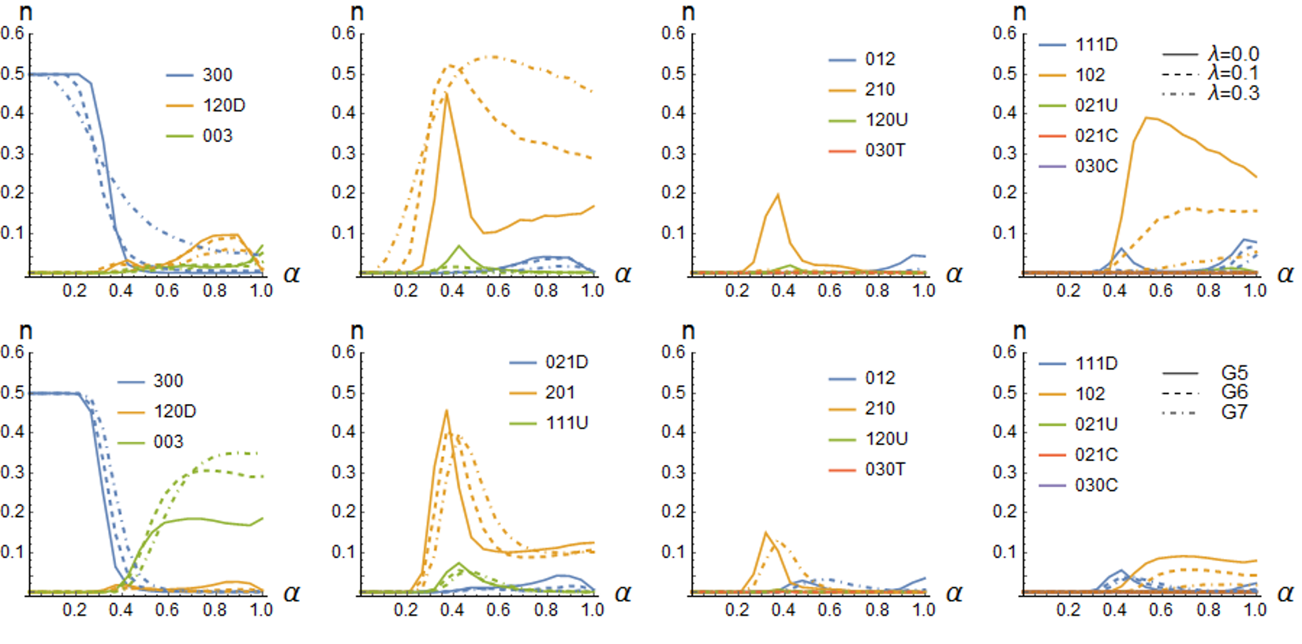
Results: Discourse patterns

Slide 13
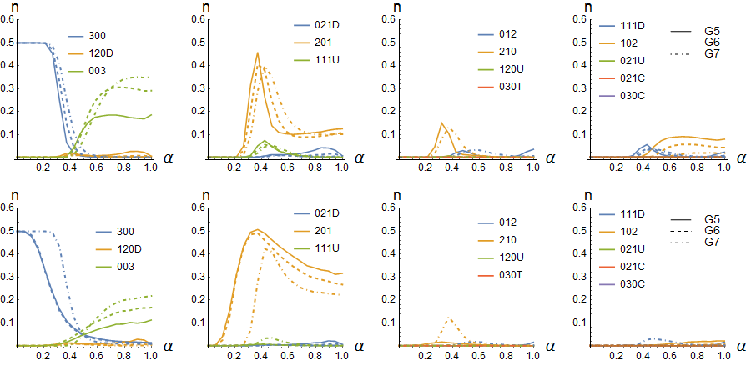

Slide 14
Conclusions
Low competitivity α < 0.4: Fully connected egalitarian triads (300).
Intermediate competitivity 0.3 < α < 0.6: Dyadic leadership type patterns (201) are dominant.
High competitivity region α > 0.5: Dyads become increasingly prominent patterns ← Strong self-reinforcing feedback effect between highly discoursive agents.
Co-operativity helps to maintain egalitarian patterns and partially egalitarian triads at high competition.
Isolation takes place at groups of five or more members when competition is high.

Slide 15
Computational modelling of sociodynamics of learning: An agent based model
D1: Target knowledge description: Epistemic landscape consisting of idealized explanatory schemes; evidence explained and proficiency required to use the scheme.
D2: Agent description; proficiency as agent’s state, memory.
D3: Social dynamics description; self-proficiency and peer-proficiency, appraisals.

Slide 16
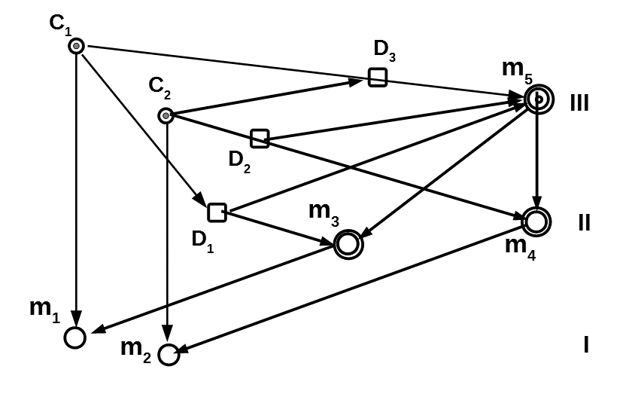
A three-tiered system of explanatory schemes:
An idealized representation of student’s explanatory models (representation of empirical findings)
Koponen (2013) Complexity 19, 27-37.
Koponen & Kokkonen (2014) Frontline Learning Research 4, 140-166. ,

Slide 17
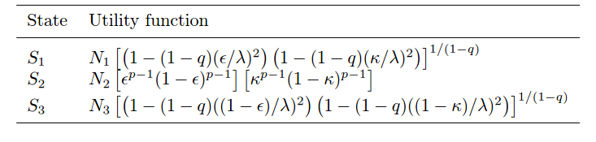
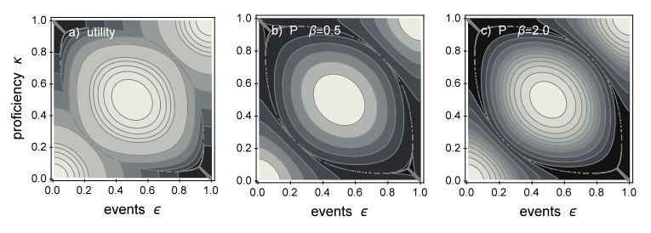
D1:A three-tiered system as epistemic landscape

Slide 18




D3: Proficiency development on basis social comparisons
Bandura’s social learning theory transformed to agent based model
Leviathan-model describing appraisal α based comparisons
[Deffuant et al. (2013) Journal of Artiﬁcial Societies and Social Simulation 16, 1–28]
Model of skill development based on memory μ± of success/failure.
[van Geert (2014) Mind,Brain, and Education 8, 57–73.]

Slide 19



D2+D3: Social learning and scheme selection
UTILITY BASED
SOCIAL BASED
Differencies only matter

Slide 20
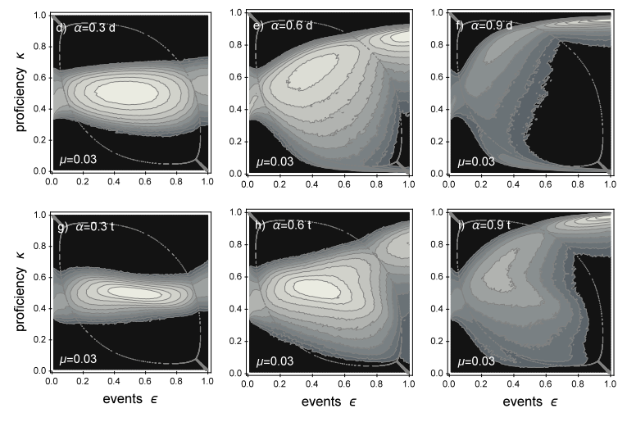
Explanatory scheme selection guided by self-proficiency and social learning

Slide 21
Comparisons with empirical results?
Problem: How in empirical results different effects are collated
Empirical settings do not attempt to resolve cognitive and social effects in learning gains ← effects are explored differently, but in similar settings.
Improving empirical settings: 1) Teaching task must be explicitely described; 2) Required proficiencies must be known;
3) Sociodynamic interaction patterns need to be known
→ Three different research traditions should be integrated to obtain better resolving power in empirical research.

Slide 22
Conclusions
Agent-Based Modelling in Educational Research
Do we need such an approach?
NO?? from viewpoint of current isolated educational research paradigms with their key conceptual constructs and research methods. The way to conceptualise the problem is too different
YES!! if more integrated research paradigm is of interest. Modelling helps to conceptualise the problem and reason about the interdependencies of different phenomena → helps to design empirical settings with better resolving power.

