Slide 1
Agent-based-model of students’ sociocognitive learning process in acquiring tiered knowledge
Ismo T Koponen
Department of Physics, Didactic Physics, University of Helsinki
MCBS 2019, Vilnius, 20th September 2019

Slide 2
Problems of interest
P1: How students acquire conceptual knowledge in a teaching-learning process?
P1a: How teaching sequences are designed?
P1b: How students make progress during teaching sequence?
P2: How students’ abilities or proficiencies develop during teaching-learning sequence and how it affects its dynamics?
P3: How social interactions affects and are affected by changes in students’ abilities or proficiencies?

Slide 3
Computational modelling of sociodynamics of learning: An agent based model
D1: Target knowledge description: Epistemic landscape consisting of idealized explanatory schemes; evidence explained and proficiency required to use the scheme.
D2: Agent description; proficiency as agent’s state, memory.
D3: Social dynamics description; self-proficiency and peer-proficiency, appraisals.

Slide 4
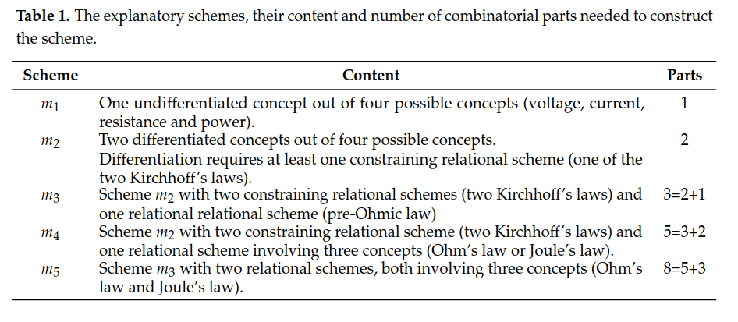

Slide 5
A three-tiered system of explanatory schemes: An idealized representation of student’s explanatory models (representation of empirical findings)
Koponen (2013) Complexity 19, 27-37.
Koponen & Kokkonen (2014) Frontline Learning Research 4, 140-166. ,

Slide 6
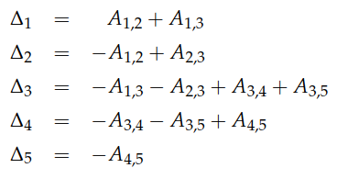
D1:A three-tiered system as epistemic landscape

Slide 7
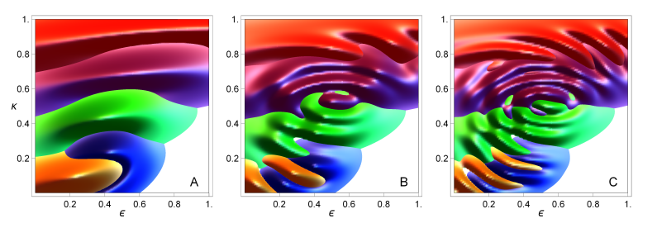

Slide 8
D2: Utility based probabilistic selection of explanatory scheme

Slide 9
D2&D3: Proficiency development on basis social comparisons
Bandura’s social learning theory transformed to agent based model
Leviathan-model describing appraisal based comparisons
[Deffuant et al. (2013) Journal of Artiﬁcial Societies and Social Simulation 16, 1–28]

Slide 10
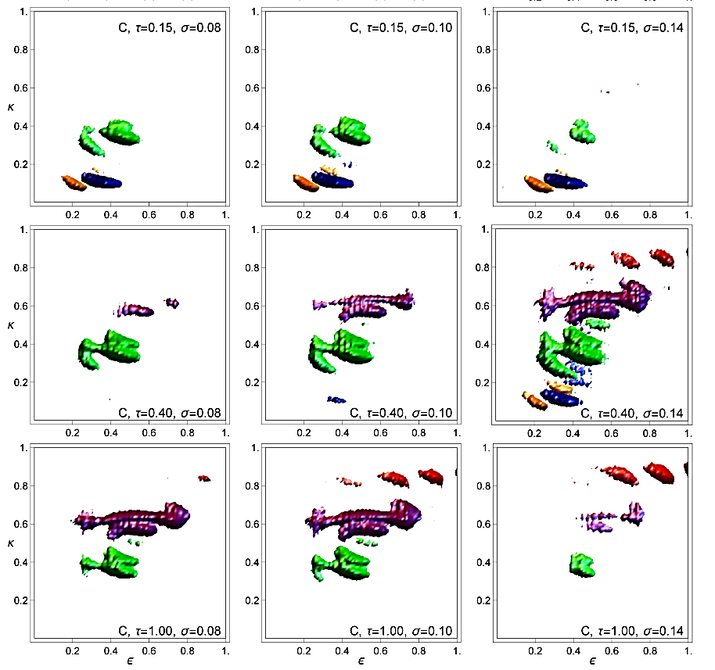
The Learning Outcome Attractors (LOAs) for epistemic landscape C.
The LOAs are recognised
as peaked regions in number density distribution nk for schemes mk, shown as: n1 (orange),
n2(blue),
n3 (green),
n4 (purple)
n5 (red).
The results are shown at different stages of evolution and for different values of diversity σ, as indicated in panels. Only densities nk > 0.1 are shown. The
darker/lighter shade indicates positive/negative gradients of nk.

Slide 11
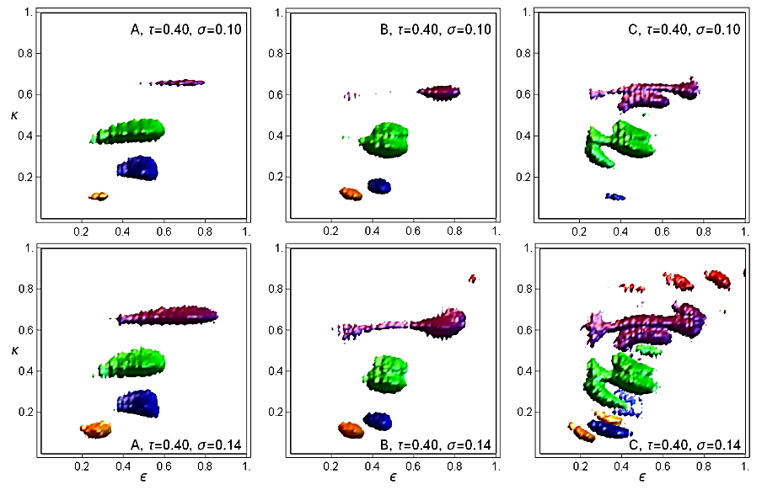
The Learning Outcome Attractors (LOAs) at the intermediate stage of evolution (τ = 0.40) compared for epistemic landscape A (no entanglement), B (entangled with λ = 3) and C (entangled with λ = 5), from left to right. The LOAs are for schemes mk, shown as: n1 (orange), n2 (blue), n3 (green), n4 (purple) and n5 (red). The results are shown for an intermediate stage of evolution τ = 0.40 and for diversity σ = 0.10 (upper panels) and σ = 0.14 (lower panels), as indicated in panels.

Slide 12
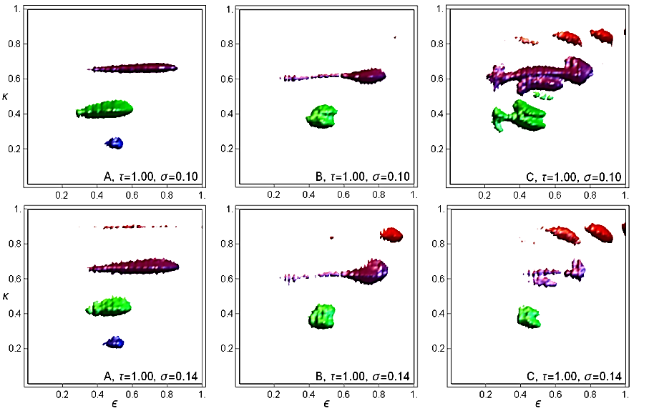
The Learning Outcome Attractors (LOAs) at the intermediate ﬁnal of evolution (τ = 1.00) compared for epistemic landscape A (no entanglement), B (entangled with λ = 3) and C (entangled with λ = 5), from left to right. The LOAs are for schemes mk, shown as: n1 (orange), n2 (blue), n3 (green), n4 (purple) and n5 (red). The results are shown for an intermediate stage of evolution τ = 0.40 and for diversity σ = 0.10 (upper panels) and σ = 0.14 (lower panels), as indicated in panels.

Slide 13
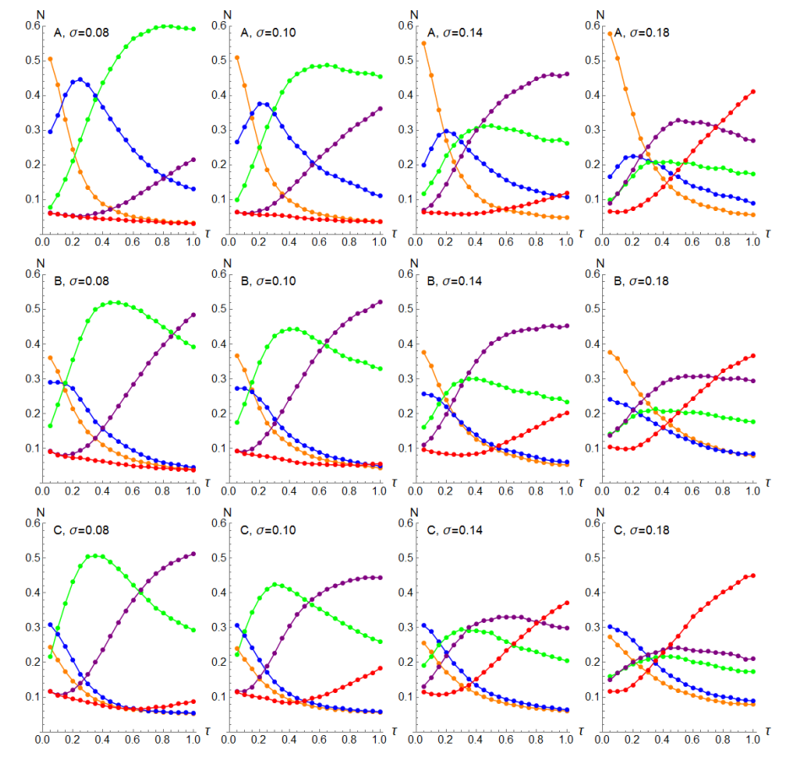
The total number density of Nk for adoption of schemes mk for epistemic landscape A (no entanglement), B (entangled with λ = 3) and C (entangled with λ = 5), from left to right.
Total number densities Nk for schemes mk, shown as: N1 (orange), N2 (blue), N3 (green), N4 (purple) and N5 (red).
Results are shown for the complete stage of evolution from τ ∈ [0, 1] to and for diversity σ = 0.08, 0.10, 0.14 and 0.18.

Slide 14
Comparisons with empirical results? Problem: How in empirical results different effects are collated
Empirical settings do not attempt to resolve cognitive and social effects in learning gains ← effects are explored differently, but in similar settings.
Improving empirical settings: 1) Teaching task must be explicitely described; 2) Required proficiencies must be known;
3) Socidynamic interaction patterns need to be known
→ Three different research traditions should be integrated to obtain better resolving power in empirical research.

Slide 15
Interpretations
Interpretation of epeistemic landscape as intructional setting
Interpretation of dynamicall robust statets as learning outcomes
Interpretation of agents’ structural relations in terms of social learning theory.
All interpretation need interpretations of parameters and exogenous variables in terms of features of learners and intructional designs.
All interpretations are on basis structural relations between exogeneous variables as compared to hypothetical/observed relations between real learners and their intaractions with instructional environment

Slide 16
Conclusions
Agent-based modelling helps:
to conceptualise the problem differently, as a complex and entangled problem (as it is) and avoid oversimplifications as separate problems (as it is not)
reason about the interdependencies of different phenomena → helps to design empirical settings with better resolving power.

