Slide 1
INTEGRATED EXAMPLAR-BASED AND Case-based APPROACHES FOR STUDENT’S LEARNING STYLE DIAGNOSIS PURPOSE
Daiva Goštautaitė, PhD student

Slide 2
Area of scientific research - personalisation of virtual learning environments
personalised recommendation engine,
personalised presentation of content,
personalised navigation,
presentation of personalised learning path,
personalised instructors,
adaptive annotation,
fragment sorting on an hypermedia course, etc.

Slide 3
Personalisation uses user model [8]
user modeling is a part of data mining operation explicitly designed for an exploration of the target audience (based on specific characteristics) and understanding the distinct patterns of its behavior;
user modeling uses descriptive algorithms to find patterns and group them to offer suggestions regarding the content for a specific audience;
purpose of user model is to:
define user intentions,
explore user background (who is, where did he come from...),
explore the context of use, i.e., user intent (for example, to keep notes),
describe user traits and preferences.

Slide 4
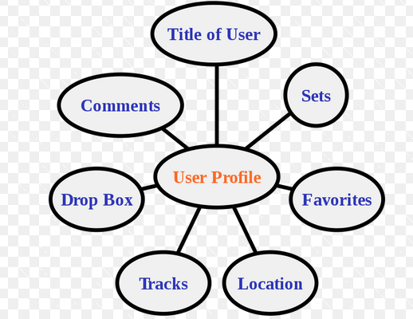
User Modeling approaches [8]
Static User Modeling: information is gathered once and remains unmodified;
Dynamic User Modeling: information is gradually updated. It may include various sets of data with multiple groupings. Approach is commonly used in recommendation engines;
User Modeling via Stereotypes: stereotypes means a generalized version of static profiles; instead of making specific accounts for each user, user data is collected into larger chunks, united by common characteristics; once there is new incoming information, the stereotypes can be updated accordingly;
Highly-Adaptive User Modeling: opposite of the stereotypical approach; an extreme form of customization that requires as much information as possible to provide the result as precise as possible.

Slide 5
User model construction [8]
gather information about users from two main sources:
the user itself (for example, upon registration or signing in via specific account or filling the form);
monitoring on-site/in-app user behavior (which pages are visited, what kind of content got clicked and so on).
Examples: transactional data (which gateway, currency, date, time, etc.), web behavior (session time, content preferences), social media activity (logins, shares, etc.), product use data (various actions, usage stats, etc.), related input text data (registration, comments, chatbot interaction, etc.)...
fed information into the data mining algorithm and extract usefull data/insights about user,
compile information into a user model/profile,
integrate user model/profile into the system and use in a variety of ways.

Slide 6
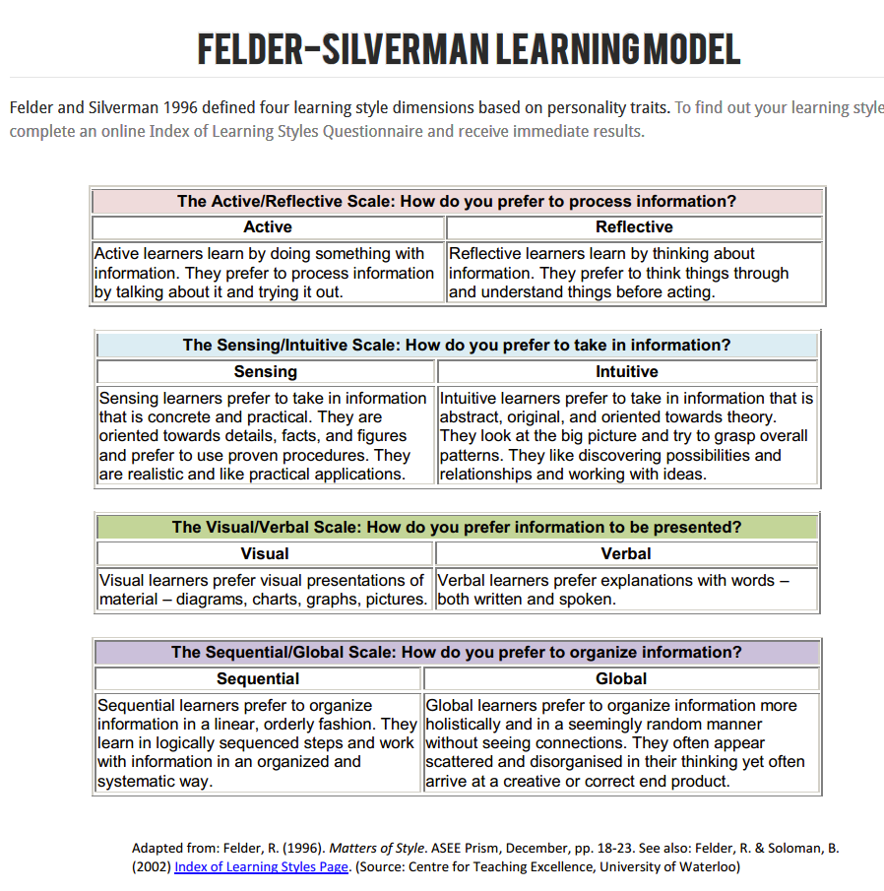
Learning styles for learner model

Slide 7
Factors influencing learning style

Slide 8
Methods of machine learning for User Modeling [8]
supervised learning classification: the algorithm is trained on labeled data and then used to classify new samples. In the meantime, it also detects unseen instances or anomalies,
supervised learning regression: the algorithm is trained to estimate the relationship and values of the variable elements,
unsupervised learning clustering: the algorithm is trained on the go with the unlabeled set of data in which it finds patterns and groups them accordingly,
random forest method: applies multiple decision trees to split up the data set into the relevant segments.

Slide 9
All models are wrong, but some are useful
weak theories for an unfinished world:
can‘t see the scope easily,
no use for the criteria of completeness and privileging;
in spite of that there is no perfect model, it is worth trying to develop more accurate and usable models that use knowledge, can analyze and understand treasure of data and can help to make decisions in the best possible way.

Slide 10
Modeling uncertainty
aleatory (statistical) uncertainty:
when the modeler does not foresee the possibility of reducing it;
deals with assigning a probability of a particular state given a known distribution;
can perfectly be modelled using Bayesian Networks: represent uncertainty about the unknown parameter by a probability distribution. This probability distribution is subjective and reflects personal judgment of uncertainty;
epistemic uncertainty:
the modeler sees a possibility to reduce it by gathering more data or by refining models (uncertainty can be reduced by more "research" improving the information position);
it may introduce dependence among random events, which may not be properly noted if the character of uncertainties is not correctly modeled;
related to cognitive mechanisms of processing knowledge, therefore some lack of knowledge exists in sense that it is limited by knowledge processing mechanisms;
also known as systematic uncertainty, which is due to things one could in principle know but doesn't in practice;
Case-based reasoning method is applied for modelling epistemic uncertainty. It is based on situation-specific experiences and episodic knowledge.

Slide 11
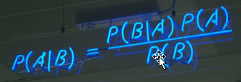
Bayesian networks
are a type of probabilistic graphical model that uses Bayesian inference for probability computations. Bayesian networks aim to model conditional dependence, and therefore causation, by representing conditional dependence by edges in a directed graph. Through these relationships, one can efficiently conduct inference on the random variables in the graph through the use of influencing factors;
the joint distribution for a Bayesian network is equal to the product of P(node|parents(node)) for all nodes, stated below:

Slide 12
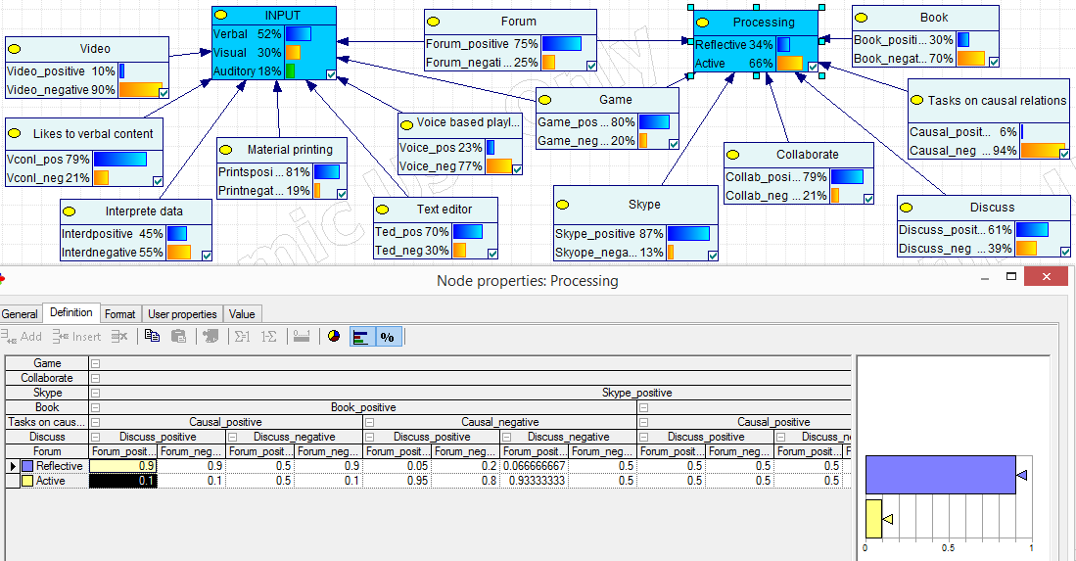
Bayesian network: graphical representation

Slide 13
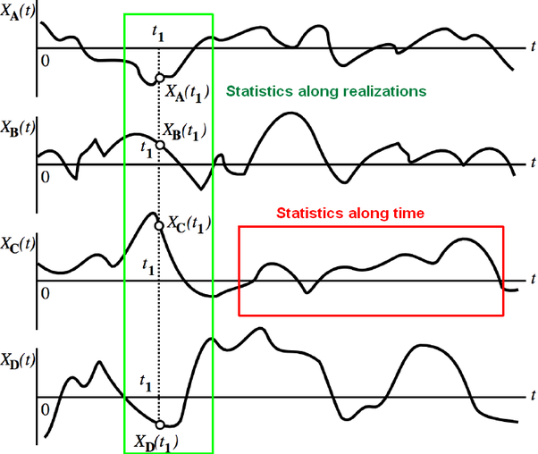
Training Bayesian network
learning Bayesian network model (parameters learning) is performing a detailed balance with regularity which converges to unique stationary distribution;
a Markov chain satisfies detailed balance if there exists a unique distribution $π$ such that for all states $y$, $y’$, $π(y)T(y−>y’) = π(y’) T(y’−>y)$. If a regular Markov chain satisfies detailed balance with distribution $π$, then there exists$t$ such that for any initial distribution $π0$, $πt(y) = π$. Here $πt(y)$ is a probability of being in state $y$at time $t$, and $T(y−>y’)$ is transition function (probability of moving from state y to state $y’$);
ergodicity is applicable – it allows interchanging statistic and temporal characteristics of some random processes (sequences): the ensemble average (average across all sample functions) equals the corresponding time average with probability 1 in limit as the observation time goes to infinity;
by the ergodic theorem, the stationary distribution is approximated by the empirical measures of the random states of the MCMC sampler; it is expected, that in a very long run samples will take values that look like draws from the target distribution (at equilibrium);
applying ergodicity for Markov chains, the following statements are true:
an irreducible Markov chain has a stationary distribution if and only if the Markov chain is ergodic;
for a process to be ergodic, it has to necessarily be stationary (but not all stationary processes are ergodic);
if the Markov chain is ergodic, the stationary distribution is unique;
in ergodic Markov chains the steady-state probability of a state is equal to the long run proportion of time the process is in that state.

Slide 14
Training Bayesian network and making inference
learning models from complete data: maximum likelihood estimate and Bayesian method (parameters become variables in a replicated model with their own prior distributions defined by hyper parameters; then Bayesian learning is just ordinary inference in the model);
learning models from incomplete data adds a layer on top of the parameter learning methods: Expectation - Maximization algorithm, Robust Bayesian estimate, Monte - Carlo method, and Gaussian approximation method;
inference in Bayesian networks refers to:
finding the probability of a variable being in a certain state, given that other variables are set to certain values; or
finding the values of a given set of variables that best explains (in the sense of the highest MAP (maximum a posteriori probability) why a set of other variables are set to certain values.
for the problem of inferring the parameter $⍬$for a distribution from a given set of data $x$, Bayes’ theorem says that the posterior distribution is equal to the product of the likelihood function $⍬→ p(x|⍬)$ and the prior $p(⍬)$, normalized by the probability of the data $p(x)$:
$$p\left(⍬,x\right)=\frac{p\left(x | ⍬\right)p(⍬)}{∫p\left(x | ⍬’\right)p(⍬’)d⍬’} (1)$$

Slide 15
Inference in Bayesian network
in most cases it is hard to do exact inference in Bayesian networks, even in simple cases, as the posterior distribution is not analytically solvable. Only few cases exist, when exact inference is possible:
when latent variable is discrete, and model is small, all possible latent variables may be enumerated: $p\left(z | x\right)=p(z,x)/\sum_{z}^{n}{p\left(z,x\right)}$,
when latent variable is continuous and some likelihood functions p(x|z) have conjugate priors, it is possible to compute posterior distribution analytically. In this case Bayesian updating means modifying the parameters of the prior distribution (called hyper parameters), and there is no need to compute integrals. For example, whereas the Dirichlet is the posterior for a multinomial distribution with a Dirichlet prior, typically, the posterior distribution in a Bayesian model will be asymptotically normal.
Definition. Dirichlet distribution Dir(α) is a family of continuous multivariate probability distributions parameterized by a vector α of positive reals. Dirichlet distributions are commonly used as prior distributions in Bayesian statistics as it is the conjugate prior for a number of important probability distributions: the categorical distribution (Bayesian case model (BCM) is a categorical mixture model) and the multinomial distribution;
in making an approximate inference using Bayesian approach few cases can also be distinguished:
using Monte Carlo methods (for example, Gibbs sampling), when posterior distribution is represented as collection of weighted samples $\{z1, z2,,…\},$
representing posterior distribution as parametric distribution and using variational methods for analytical approximation to the posterior probability of the unobserved variables,
making amortized inference: learning to do inference quickly (“bottom-up”, “pattern-recognition”, “data-driven”).

Slide 16
Markov Chain Monte Carlo (MCMC) method
MCMC methods are used to approximate the posterior distribution of a parameter of interest by random sampling in a probabilistic space;
the idea of Monte Carlo method which is being used for making an approximate inference is to use some agent (for example, Gibbs sampler) to sample from prior distribution and weight by likelihood (or transform samples so that they become samples from the posterior);
by constructing a Markov chain that has the desired distribution as its equilibrium distribution, one can obtain a sample of the desired distribution by recording states from the chain. The more steps are included, the more closely the distribution of the sample matches the actual desired distribution - in a very long run samples will take values that look like draws from the target distribution (at equilibrium);
samples from a distribution are drawn and some expectation is approximated using the sample average rather than calculating a difficult or intractable integral;
uses Gibbs sampling for estimation of the model parameters, i.e. evaluation of the conditional posterior distribution of each variable conditioned on the other variables;
the parameter value simulated from its posterior distribution in one iteration step is used as the conditional value in the next step;
repeating the process provides the result of an approximate random sample to be drawn from the posterior distribution.

Slide 17
MCMC method
integrals described by the expected value of some random variable can be approximated by taking the empirical mean (the sample mean) of independent samples of the variable;
random sampling inside a probabilistic space is performed to approximate the posterior distribution;
using MCMC method, we’ll effectively draw samples from the posterior distribution, and then compute statistics like the average on the samples drawn;
since the random samples are subject to fixed probabilities, they tend to converge after a period of time in the region of highest probability for the parameter we’re interested in;
after convergence has occurred, MCMC sampling yields a set of points which are samples from the posterior distribution.

Slide 18
Gibbs sampling -
for obtaining a sequence of observations which are approximated from a specified multivariate probability distribution, when direct sampling is difficult:
samples from probability distributions of 2+ dimensions;
accepts all proposals;
uses the Markov chain Monte Carlo method - samples are dependent on each other;
at each iteration thgough the loop: select just one non-evidence variable and resample it, conditioned on the other variables;

Slide 19
Gibbs sampling algorithm

Slide 20
Collapsed Gibbs sampler
If you have some function of x and y then ∫f(x,y)dx=g(y) - the x is "integrated out"
Gibbs sampler which integrates out (merginalizes over) one or more variables when sampling for some other variable is called collapsed Gibbs sampler;
one or some parameters $xi$ (called nuisance parameters) may be eliminated by integrating them out, i. e. marginalizing (focusing on the sums of distributions in the margin) over the distribution of the variables being discarded;
marginalisation is a method that requires summing over the possible values of one variable to determine the marginal contribution of another ( P(happiness|weather) = P(happiness, country=England | weather) + P(happiness, country=Scotland | weather) + P(happiness, country=Wales | weather));
variable that is summed is known as the “nuisance variable”;
when we integrate out a parameter, the efect for most purposes is to estimate the parameter from the data, and then constrain the parameter to that value;
in probablistical graphical models marginalisation is a method by which we can perform exact inference (i.e. we can write down the exact quantity from the distribution we’re interested in, e.g. the mean can be calculated exactly from the distribution). In this context marginalisation is a method of, and sometimes used synonymously with, variable elimination.

Slide 21
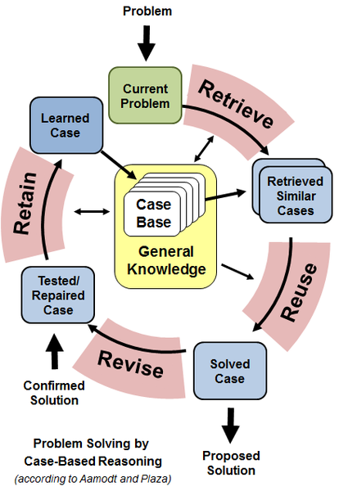
Case-based reasoning (CBR):
a method which helps to solve new
problems using knowledge from the past
cases,
divides an experience into two parts: a
problem part (description of a problem
situation) and a solution part
(description of the reaction to a situation),
two major ways for problem formulation: standardized formulation (using mathematical models, formulas, etc.) and interactive formulation, using user’s feedback or dialogue with user,
to reuse cases from past, a recorded experience needs to be similar to the new problem. Typically, the new case is most similar to the nearest neighbour’s case, therefore the global similarity must be computed:
$\sum_{i=1}^{n}{(w_{i}∗sim\left(x_{i},y_{i}\right)}|1≤i≤n$) .

Slide 22
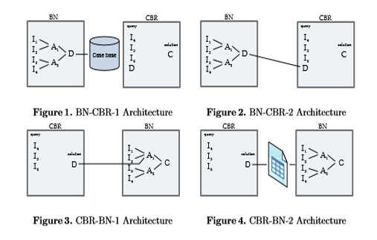
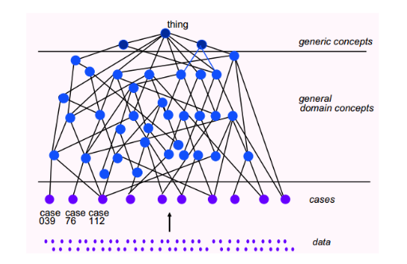
Two main trends for BN+CBR modelling [9], [10]
based on employment of simple or optimized Bayesian network and CBR, combining these two by common parameters’ space:
approach is reasonable for cases when BN is constructed by experts, using learning style model known in advance;
inferences about dominating learning style of student can be made, also proportions of student’s style according to the learning style model chosen can be concluded;

Slide 23
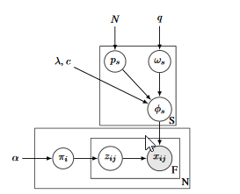
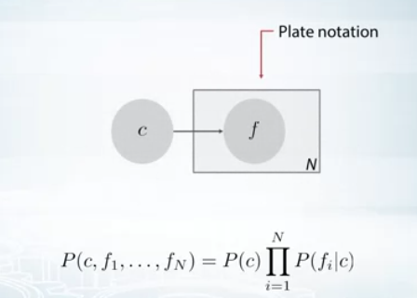
Two main trends for BN+CBR modelling
examplar-based: doesn’t use previously defined learning style model – for each student, model is generated from his/her behavioral data or students’ past cases’ data;
example – Bayesian Case model:
$ϕ_{sj}∼Dirichlet\left(g_{psj, wsj,λ}\right) ∀ s, j$; where $g_{psj, wsj,λ}\left(v\right)= λ(1+{c1}_{\left[w_{sj}=1 and p_{sj}=⍬\right]})$;
$p_{s }∼Uniform\left(1,N\right) ∀ s$ ;
$w_{sj}∼Bernoulli\left(q\right) ∀ s, j ;$
$π_{i}∼Dirichlet\left(α\right) ∀ i ;$
$z_{ij}∼Multinomial\left(π_{i}\right) ∀ i, j$ ;
$x_{ij}∼Multinomial\left(ϕ_{zijj}\right) ∀ i, j$ ;

Slide 24
BCM: clusters, prototypes, subspaces
BCM generates prototype (example –
actual data point that best represents the
cluster) and subspace (set of important
features) for each cluster;
in subspaces, binary variable has value 1
for important features;
important features are whatever the particular cluster has in common (and also the rest has high likelihood in the entire generative process), and unimportant features are the ones where if they are changed arbitrarily, their cluster membership doesn't change;
prototype and subspace form an explanation of a cluster; an explanation consists of real data examples;
BCM makes joint inference on cluster labels, prototypes and subspaces;
for students’ learning style modelling using BCM, cluster represents learning style, and features (behavioral activities) have cluster labels;

Slide 25
BCM clusters, subspaces, prototypes for learning style modeling
interpretable models and methods for interpretation enable humans to comprehend why certain decisions or predictions have been made;
interpretability means the degree to which a human can consistently predict the model’s result;
one can describe a model as interpretable if he/she can comprehend the entire model at once;
Explanation for each cluster will consist of:
prototype presented as log of behavioral activities of student which best represents the cluster (or best represents learning style assigned to the cluster);
subspace of important features, i. e. behavioral activities that have been performed most frequently in the virtual hypermedia learning environment by students whose learning style corresponds to the style represented by the cluster;

Slide 26
Parameters in BCM
parameters can help in defining or classifying a particular system,
parameters of the priori are called hyper parameters,
in mixture model, using Bayesian setting, the mixture weights (mixture probability) and parameters themselves are random variables, and prior distributions will be placed over the variables,
the weights are typically viewed as a K-dimensional random vector drawn from a Dirichlet distribution (i. e. from the conjugate prior of the categorical distribution), and the parameters will be distributed according to their respective conjugate priors,
in BCM $c$ and $λ$ are constant hyper parameters that indicate how much the prototype will be copied in order to generate the observations. Setting $c$, $λ$ and $q$ can be done through cross-validation, another layer of hierarchy with more diffuse hyper parameters, or plain intuition;

Slide 27
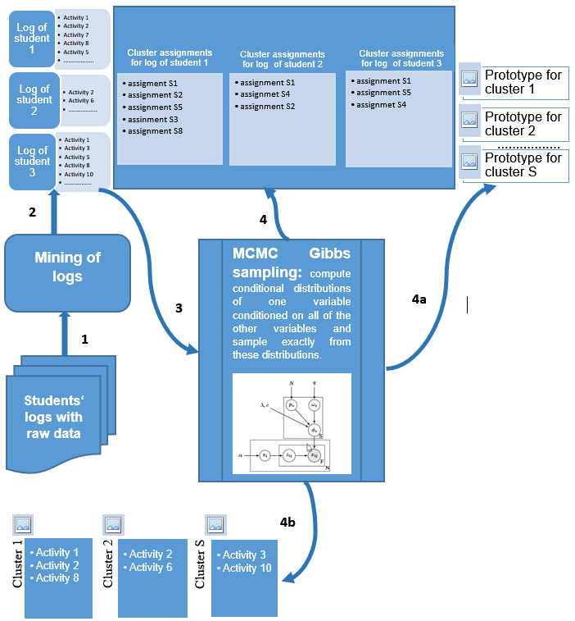
BCM application for student‘s learning style modelling
each log should be presented as bag of independent data objects corresponding to student’s behavioral activities influencing his/her learning style (data objects are correlated in some way representing student’s learning style);
distribution over clusters (cluster proportions) will be assigned for each student’s log, and dominating learning style from the set of K styles will be assigned to the learner;
each learner will be assigned the
highest probable cluster that
corresponds to learning style
presented by learner’s actual
co-occurring behavioral activities
in VLE.
BCM uses generative story
to explain parameters (brute-force,
can‘t add features);

Slide 28
Bayesian Case model (BCM)
a general framework for Bayesian case-based reasoning (CBR) and prototype classiﬁcation and clustering. It brings the intuitive power of CBR to a Bayesian generative framework, performing joint inference on clustering and explanations of the clusters;
BCM is a generative statistical model that has clustering and explanation parts [1] - [7]; it can specify a joint probability distribution over observed variables and latent variables, i. e. given an o$bservable variable X$ and a $target variable Y,$ it models the joint probability distribution on $X × Y;$
in BCM, the underlying structure of the observations is represented by a standard discrete mixture model [7]. BCM treats data as a mixture of several components, assuming that each data point belongs to one of the components, and each component has a simple parametric form. Thus, having N observations (x={$x_{1}$,$x_{2}$,...,$x_{N}$ }), each $x_{i}$ represents a random mixture over clusters;
each feature 𝑗 of the observation$i$ (${ x}_{ij}$ ) comes from one of the clusters (each feature is labeled and assigned to a cluster: data point is distribution over clusters)), the index of the cluster for $x_{ij}$ is denoted by $z_{ij}$ and the full set of cluster assignments for observation-feature pairs is denoted by $z$. Each $z_{ij}$ takes on the value of a cluster index between 1 and $S$ [7];
BCM augments the standard mixture model with prototypes and subspace feature indicators that characterize the clusters;
BCM captures dependencies among features via prototypes.

Slide 29
Mixture model
„Mixture models" are used to make statistical inferences about the properties of the sub-populations given only observations on the pooled population, without sub-population identity information;
BCM is a mixture model: it treats data as a mixture of several components, assuming that each data point belongs to one of the components, and each component (cluster) has a simple parametric form;
when you have multiple features for a data point, BCM assigns a label for each of these features instead of assigning one data to one cluster – flexible;

Slide 30
BCM clustering part [1]-[7]
in BCM generative story, clusters are generated first of all (each data point is repesented by distribution over clusters): labels are assigned to each of the features in the log document (result – distribution of features over clusters);
prototype $p_{s }$ is generated by sampling uniformly over all observations, i. e. initially it is presumed that every cluster is equally probable;
if nothing is known about a distribution
except that it belongs to a certain class
(usually defined in terms of specified
properties or measures), then the
distribution with the largest entropy
should be chosen as the
least-informative default;

Slide 31
BCM clustering part [1]-[7]
mixture weights $π_{i}$ (proportion of elements in each cluster) are generated according to a Dirichlet distribution, parameterized by hyper parameter ;
hyperarameter 𝛼 “controls” how many different clusters we want to have per data point;
to use BCM for classification, vector 𝜋𝑖 is used as 𝑆 features for a classifier, which categorizes unlabeled data, representing the examples as points in space, mapped so that the examples of the separate categories are divided by a clear gap that is as wide as possible;
new examples are then mapped into
that same space and predicted to
belong to a category based on which
side of the gap they fall ;
Dirichlet is conjugate prior for
categorical (multinomial) distribution,
therefore sampling is not necessary in
this case as it is possible to marginalize
and evaluate probability distribution
exactly;

Slide 32
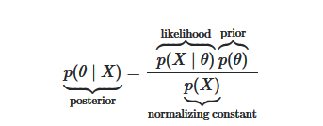
BCM inferences
in BCM, features of each observation come from one of the clusters. Presuming that behavioral activities of a student co-occur as he/she has a particular learning style, using BCM we can infer the learning style with the highest probability;
uses Markov Chain Monte Carlo method (initialization to random variables, keeping the evidence values fixed; iteratively in the loop sample just one variable at the time conditioned on all the others(random walk: https://www.youtube.com/watch?v=QaojSzk7Hpw)); since previous data points are dependent on the new data (Markov chain: each sample is dependent on the previous sample), Gibbs update on a randomly chosen subset of the new full data set is performed;
result of Gibbs sampling is cluster assignmets (labels) (behavioral activities in student’s log is probabilistically distributed over clusters instead of assigning the log to one single cluster);
for the problem of inferring the parameter θ for a distribution from a given set of data x, Bayes’ theorem says that the posterior distribution is equal to the product of the likelihood function θ → p(x|θ) and the prior p(θ), normalized by the probability of the data p(x);
prior is assumed here to be arising from the Dirichlet Distribution.

Slide 33
BCM: explanations [1]-[7]
subspaces are incorporated in a cluster using $g_{psj, wsj,λ}$ function and making $g_{psj, wsj,λ}$ a hyperparameter for a Dirichlet distribution that $φ_{s}$ is sampled from;
$φ_{s}$ describes the cluster s;
$g_{psj, wsj,λ}$ : put same „bump“ for all the possible features, except if the feature is important and you happen to have the same feature value as the prototype, then raise the „bump“ – a way of measuring the similarity;
$c$ and $λ$ are constant hyper parameters that indicate how much the prototype will be copied in order to generate the observations;

Slide 34
BCM: interactive part
capable to use a feedback from a user and integrate knowledge transferred interactively into the model;
users provide direct input to iBCM in order to achieve effective clustering results, and iBCM optimizes the clustering by achieving a balance between what the actual data indicate and what the user indicates as useful;

Slide 35
BCM application
students‘ learning style clusters generated by BCM might be used:
for personalization of virtual learning environment according to student’s needs;
by teachers helping them to prepare versions of courses relevant to prototypes and important features of particular clusters.

Slide 36
Literature, links, sources
[1]Been Kim, Thynthia Rudin, Julie Sah, “The Bayesian CASE model: a generative approach for case-based reasoning and prototype classification”, Neural Information Processing Systems (NIPS), 2014.
[2]Been Kim, Elena Glassman, Brittney Johnson, Julie Shah, “iBCM: interactive Bayesian case model empowering humans via intuitive interaction”, Computer Science and Artificial Intelligence Laboratory Technical Report, 2015.
[3] Been Kim, “Interactive and interpretable machine learning models for human machine collaboration”. Retrieved from: https://vimeo.com/234601515.
[4] Been Kim, “Interactive and interpretable machine learning models for human machine collaboration”, Microsoft research talk, 2015. Retrieved from: https://www.microsoft.com/en-us/research/video/interactive-and-interpretable-machine-learning-models-for-human-machine-collaboration/.
[5] Been Kim, “Interactive and interpretable machine learning models for human machine collaboration”. Retrieved from: https://vimeo.com/144178224.
[6] Been Kim, “Bayesian Case Model -- generative approach for case-based reasoning and prototype”. Retrieved from: https://www.youtube.com/watch?v=xSViWMPF7tE.
[7] Been Kim, “Interactive and Interpretable Machine Learning Models for Human Machine Collaboration”, submitted to the Department of Aeronautics and Astronautics in partial fulﬁllment of the requirements for the degree of Doctor of Philosophy in Aeronautics and Astronautics at the Massachusets institute of technology
[8] Retrieved from: https://theappsolutions.com/blog/development/what-is-user-modeling-and-personalization/ .
[9]Hoda Nikpour, “Prediction and explanation by combined model-based and case-based reasoning”, ICCBR Workshops, 2016.
[10]Tore Bruland, Agnar Aamodt, Helge Langseth, “Architectures Integrating Case-Based Reasoning and Bayesian Networks for Clinical Decision Support”, Intelligent Information Processing V - 6th IFIP TC 12 International Conference, 2010.
[11] Joint, Marginal, and Conditional Distributions. Retrieved from www.talkstats.com/threads/integrating-a-probability-out.11888/ .

