Slide 1
POSSIBILITIES OF APPLICATION OF MULTICRITERIA DECISION MAKING METHODS FOR EVALUATION OF ICT USAGE IN BUSINESS
Dalė DZEMYDIENĖ; Giedrė DZEMYDAITĖ; Dinesh GOPISETTI
Vilnius University, Vilnius Gediminas Technical University Lithuania
V. R. Siddhartha Engineering College, NH-9, Kanuru, AP, India
dale.dzemydiene@vgtu.lt; giedre.dzemydaite@evaf.vu.lt dinesh.gopisetti@stud.vgtu.lt

Slide 2
Content of presentation
Research area;
Aims and objectives of research;
Layers of ICT structure in business;
Multi-dimensional decision support methods;
Results of evaluation of ICT usage in EU countries by applying TOPSIS and SAW methods;
Conclusions

Slide 3
Research area
Business management systems provide functionality for business enterprises, enabling to maintain data about usage and management of all types of resources.
The statistical information helps us to reveal information about functioning of enterprises and implementing of ICT.
Our research area concerns the methods for the evaluation of ICT usage in businesses and possibilities to evaluate the spectrum of different kinds of used systems.

Slide 4
Situation of ICT usage and problems
In the most recent decade, extraordinary changes were achieved in numerous business areas, including manufacturing industry, retail or other sectors.
ICT assets are renovated and re-engineered regular in the areas of bookkeeping, marketing/sales, finance, supply, production planning and human resources.
The ICT usage in businesses enterprises have differentiations.

Slide 5
The aim of research
To analyze differentiations of ICT usage in small and medium enterprises (SME) by enabling the evaluation of development of business.
Special view is paid for business management systems and ICT usage differentiation in SME and their benefit.

Slide 6
OBJECTIVES
To analyze the possibilities of application of multicriteria decision making methods for evaluation of ICT usage in business for development of business.
To analyze the methods for recognition of different alternatives of decision making in the ICT implementation area of business enterprises.

Slide 7
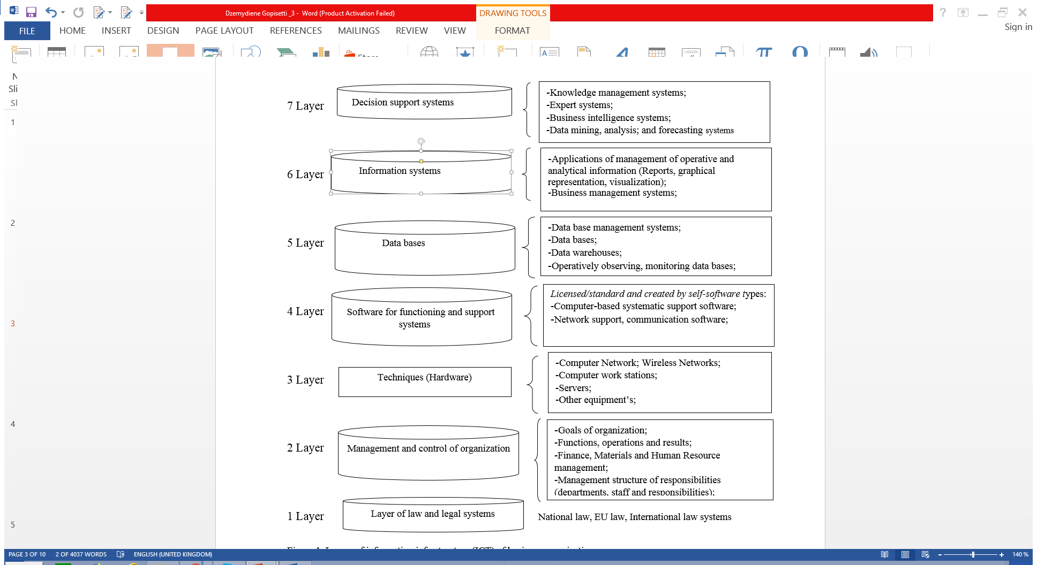
Layers of information infrastructure (ICT) of business organization

Slide 8
Layers of information infrastructure (ICT) of business organization
The infrastructure contains layer of law and legal systems, layer of management and control, layer of hardware, layer of software, layer of databases, layer of information systems, and layer of decision support systems.
Types of Management Information Systems (MIS) and Business Management System (BMS) vary from the different kinds of Enterprise Resource Planning (ERP) systems (such as SAP, Microsoft Axapta, Navision, Dynamics, Oracle Business Suite, etc.)
SME apply Business Intelligence Systems (BIS).

Slide 9
Methods used for evaluation of the ICT usage
TOPSIS method - the Technique for Order of Preference by Similarity to Ideal Solution;
SAW method - the Simple Additive Weighting method.

Slide 10
Dynamics of usage of ICT in all types of business enterprises
Year Country | 2013 | 2014 | 2015 | 2016 | 2017
LITHUANIA | 75.2 % | 74.53 % | 77.28 % | 77.03 % | 78.03 %
FRANCE | 65.3 % | 63.59 % | 66.82 % | 68.5 % | 66.53 %
UNITED KINGDOM | 81.98 % | 79.69% | 80.76 % | 82.99 % | 88.63 %
GREECE | 60.59 % | 61.85 % | 60.95 % | 65.89 % | 64.77 %
LATVIA | 55.66 % | 55.86 % | 58.95 % | 63.49 % | 62.93 %
Source: Official statistical data (https://stats.oecd.org)

Slide 11
Results of Evaluation EU countries by ICT usage using TOPSIS method
 | 2013 | 2014 | 2015 | 2016 | 2017 | si+ | si- | pi | Rank
LITHUANIA | 0.098301 | 0.098513 | 0.099459 | 0.095755 | 0.095821 | 0.019221 | 0.049448 | 0.720089 | 2
FRANCE | 0.085359 | 0.084053 | 0.085997 | 0.085151 | 0.081699 | 0.048074 | 0.020594 | 0.299906 | 3
UNITED KINGDOM | 0.107163 | 0.105334 | 0.103938 | 0.103163 | 0.108838 | 0 | 0.067434 | 1 | 1
GREECE | 0.079203 | 0.081753 | 0.078443 | 0.081907 | 0.079537 | 0.05743 | 0.011174 | 0.162872 | 4
LATVIA | 0.072758 | 0.073835 | 0.075869 | 0.078923 | 0.077278 | 0.067434 | 0 | 0 | 5

Slide 12
Results of ICT usage in EU countries by SAW method
 |  | WEIGHT | LITHUANIA | FRANCE | UNITED KINGDOM | GREECE | LATVIA
2013 | MAX CRITERIA | 0.20 | 0.1834594 | 0.159307 | 0.2 | 0.147817 | 0.135789
2014 | MAX CRITERIA | 0.20 | 0.1870498 | 0.159593 | 0.2 | 0.155227 | 0.140193
2015 | MAX CRITERIA | 0.20 | 0.1913819 | 0.165478 | 0.2 | 0.150941 | 0.145988
2016 | MAX CRITERIA | 0.20 | 0.1856368 | 0.16508 | 0.2 | 0.15879 | 0.153006
2017 | MAX CRITERIA | 0.20 | 0.1866077 | 0.159106 | 0.2 | 0.154897 | 0.150496
 |  | SUM | 0.9341356 | 0.808564 | 1 | 0.767671 | 0.725473
 |  | RANK | 2 | 3 | 1 | 4 | 5

Slide 13
CONCLUSIONS
After analysing of the statistical data about the ICT usage in business during the period of 2013 and 2017 in choose countries of EU by using of two methods - TOPSIS and SAW, we can see which country has the best ICT usage and access.
The provided methods allow to revealed which country ranks first in ICT usage.
By the evaluation of ICT usage in Lithuania in comparison with the other countries, development in all businesses by implementing ICT was analyzed.

Slide 14
LIMITATIONS
The limitation of this research is an analysis of five countries and an application of two multi-criteria decision making methods (TOPSIS and SAW).

Slide 15
THANK YOU FOR ATTENTION
Prof. Dr. Dalė Dzemydienė
Ass. Prof. Dr. Giedrė Dzemydaitė
Master student Dinesh Gopisetti
Vilnius University,
Vilnius Gediminas Technical University Lithuania
V. R. Siddhartha Engineering College, NH-9, Kanuru, AP, India
dale.dzemydiene@vgtu.lt; giedre.dzemydaite@evaf.vu.lt dinesh.gopisetti@stud.vgtu.lt

