Slide 1
Towards a healthy body weight: the prevention of obesity
Prof. Dr. Dorien DeTombe (MSc. Ph.D.)
Sichuan University, Chengdu, P.R. China
Founder International Research Society on
Methodology of Societal Complexity
Amsterdam The Netherlands, Europe
T : +31 20 6927526
E : detombe@nosmo.nl
W :www.doriendetombe.nl

Slide 2
Outline
  obesity
  societal complexity
  Compram Methodology

Slide 3
obesity
what do we see
people in the USA and in Europe eat
too much unhealthy food & gain too much weight

Slide 4


Slide 5


Slide 6
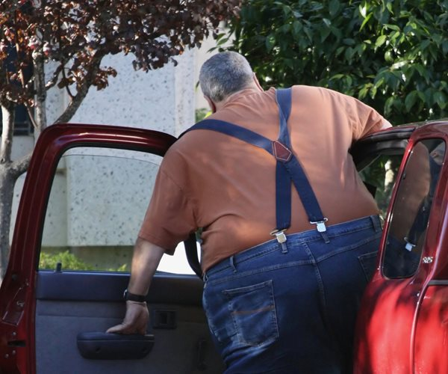

Slide 7
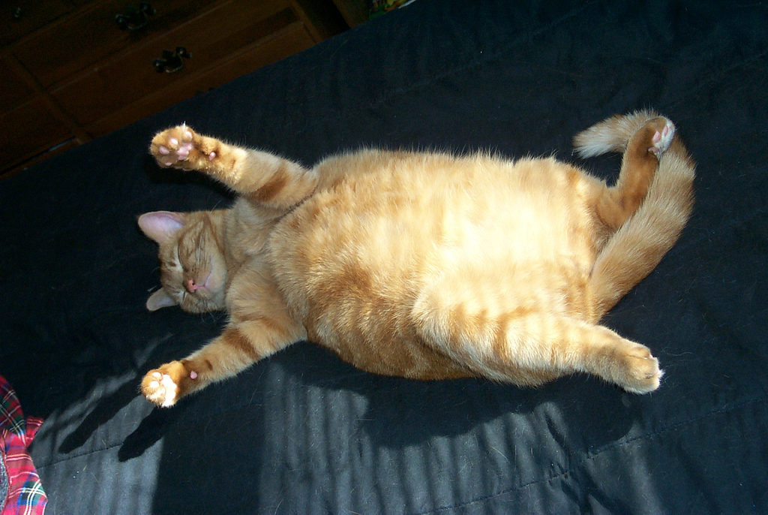

Slide 8
Netherlands
overweight and obesity 2008
52.5% overweight including 18.8% obese.
men (56.4%)
women (48.7%)
Netherlands - WHO Country Profile - WHO/Europe - World ...

Slide 9
fattest?
Tonga, Samoa and Kiribati islands pacific
4/5 overweight or obese.
Middle Eastern countries – Qatar, Kuwait, Libya, Egypt, and Saudi Arabia. 2015

Slide 10
USA
2018:
Behavioral Risk Factor Surveillance System (BRFSS) data,
between 35% and 22,6 %

Slide 11
Japan 3.2%.
lowest rate of obesity
of OECD member countries (WHO)

Slide 12
difficult to change consumption habits
addiction to sweetened and fat food

Slide 13
class problem
working class ---- different --- intellectuals
both influenced by
peers, family, environment

Slide 14
Iife style
problematic family
combination of problems
unemployment
debts
no sports
alcohol
smoking
drugs

Slide 15
intellectuals read and belief
‘poor’ working class people unhealthy life
live 7 years shorter than intellectuals
18 years before death have more physical trouble
ASSEN (The Netherlands ) 2018
working class people do not want
the government to interfere

Slide 16
The Dutch National Prevention plan
government change unhealthy habits
soft + hard measurements
more healthy food in school and sports and supermarkets
no drugs
no drinking
no smoking

Slide 17
goal fitter society in 2040
government + business + private
eating<
+
better food fruit vegetables, whole wheat, water
moving >

Slide 18
commercial enterprises money
advertising, offering in the streets, making it easy to buy ‘unhealthy’ food
harder and more expensive to buy healthy food

Slide 19
obesity is a complex societal problem

Slide 20


DeTombe, Dorien (2015)
Handling Societal Complexity. A Study of the Theory and the Methodology of Societal Complexity and the COMPRAM Methodology.
Heidelberg: Springer Verlag. ISBN /EAN 978-3-662-43916-6.(550 pages)

Slide 21
complex societal problems problems on the front page of the quality newspapers

Slide 22
policy making
for handling societal complexity
in order to implement changes

Slide 23
complex societal problems
what is it
what causes it
who is suffering
who has the benefit
who can change it
how can it be changed

Slide 24
theory of Societal Complexity
and the Compram methodology
supports policy making in
handling complex societal problems

Slide 25
Methodology of Societal Complexity supports decision making for politicians on local, state and global level using the Compram Methodology

Slide 26
Definition of Complex Societal Problems DeTombe 2005 (1)
a complex societal problem is a real life problem, which has a large however often different impact on different groups in the society. The problem has often an impact on all the levels of the society, on micro, meso and macro level.
Often it seems that the problem suddenly ‘pops-up’. The problem is dynamic, it changes during its development. The future development of the problem is uncertain.
It is often difficult to become aware of the problem and difficult to put it on the political agenda. It is difficult to get grip on the problem and to handle the problem. Only changes are possible, no ‘solutions’.
Notes:
Difficuklt to put on lolitical agenda abortion women the nethelands

Slide 27
Definition of Complex Societal Problems DeTombe 2005 (2)
The problem has a knowledge, a power and an emotional component.
The problem consist of many phenomena which are complicated intertwined with each other. Often there is a lack of knowledge, the data are incomplete, uncertain or in contradiction with each other. The problem is interdisciplinary and it needs theories from different fields to explain what is happening.
There are many parties involved. Each party has a different view on the problem, a different definition of the problem, and has different goal and desires. The different parties have different power over the problem. The parties often have different ‘solutions’ for the problem.
The problem often provokes much emotion in society.

Slide 28
benefits are privatized
costs are socialized

Slide 29

complex problem handling methodology
DeTombe
selected in 2006 by the OECD to handle Global safety
Compram-DeTombe
29
Notes:
Compram
29

Slide 30
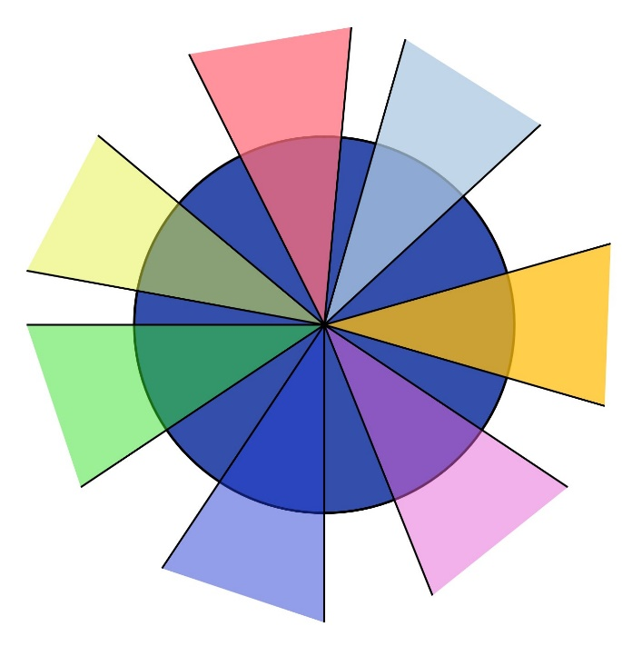
the Compram Methodology

Slide 31
COMPRAM Methodology: 3 basic elements
each complex societal problem has
  knowledge
  power
  emotion
Compram-DeTombe
31
Notes:
Compram
31
knowledge, power and emotion element

Slide 32
the Compram Methodology
how does it works?

Slide 33
COMPRAM Methodology: how does it works?
6 steps
step1 team of experts model the problem knowledge
step 2 actors model the problem power
step 3 experts + actors find interventions
step 4 societal reactions emotion
step 5 interventions implemented
step 6 interventions and process evaluated
Compram-DeTombe
33
Notes:
Compram
33
(Take 6-12 months)
Only mentioning as a overview not yet discuss indicate the distinction with the problem handling phases see next slide

Slide 34
COMPRAM Methodology: =====
and phases of the problem handling process
defining the problem
awareness mental idea agenda team hypotheses conc.model
__1.1__ __1.2__ __1.3__ _1.4___ _1.5__ __1.6__
===================
changing the problem
emp. model handling space scenario intervention implementation evaluation
_2.1___ _2.2___ _2.3___ __2.4__ __2.5__ __2.6__
========================================
Compram-DeTombe
34
Notes:
Compram
34
Compram methodology handles all phases of the problem handling process
Now we are already in phase 1.4 forming a team based on the idea which field are involved in the problem
Always policy makers: we are in the middel of the problem handlinG process never at the start

Slide 35
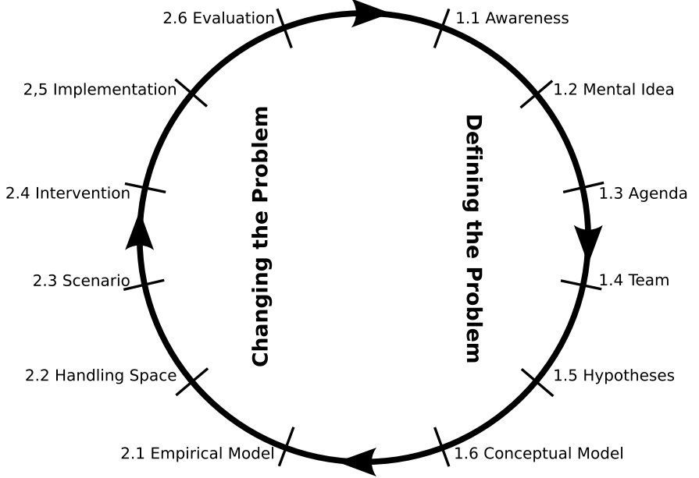
Compram-DeTombe
35
Notes:
Compram
35
The same phases seen as they are a continuing

Slide 36
COMPRAM Methodology
step 1 knowledge experts
problem owner ask facilitator to invite experts based on (vague) idea of the problem
experts discuss in 6 or more meetings the problem
define the problem: by making conceptual model of the problem
report
Compram-DeTombe
36
Notes:
Compram
36

Slide 37

each expert sees a part of the problem
experts
communication and exchanging knowledge
Compram-DeTombe
37
Notes:
Compram
37

Slide 38
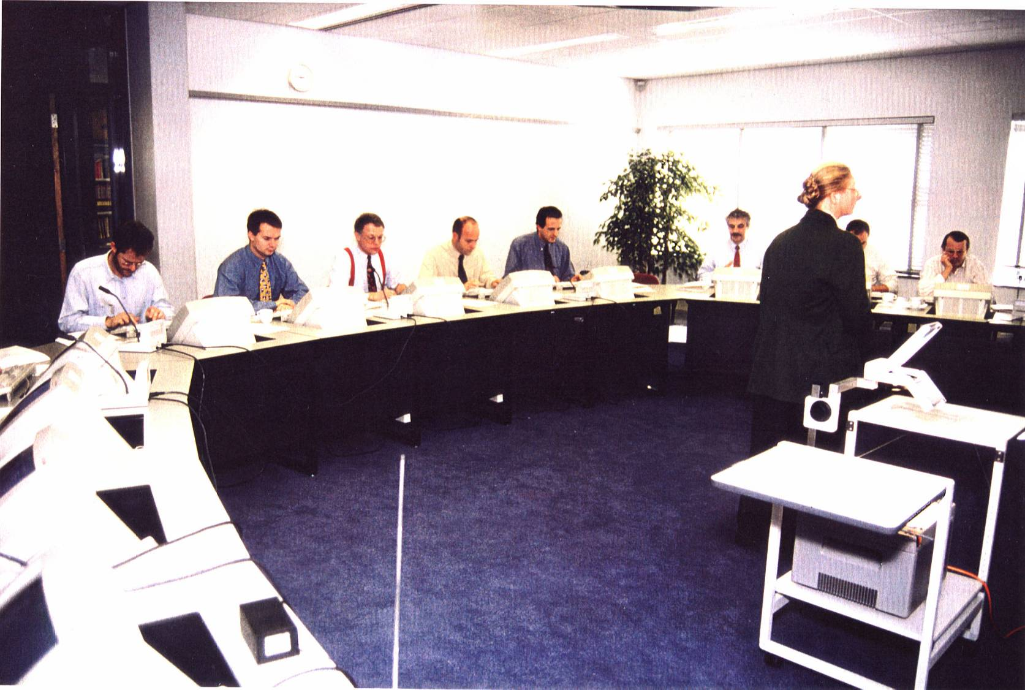
co-operative problem handling

Slide 39
COMPRAM
The seven layer communication model
DeTombe (1994)
Compram-DeTombe
39
Notes:
Compram
39
Devils advocate role avoiding group think
Expert support groups
definition is depending of the quality of the group and the facilitator hard to avoid hidden agenda’s but be aware
There are always white sport and blind spots

Slide 40
system dynamic model
non-linear feedback loops
conceptual model
discussion model
funding of disasters

Slide 41
COMPRAM Methodology
step 2 actors: power
facilitator invites based on definition of the problem the
different actor groups
each actor group discusses (parallel) in 6 or more meetings
model of the problem filling the 7-layer model
define the problem, desired goals, objections, support
report

Slide 42
COMPRAM Methodology
actors/ stakeholders/ parties involved in the problem have:
their own view, own goals, own hidden agenda’s
different power
are: victim or profiteer
actors are needed for implementing the changes

Slide 43
each actor sees a piece of the problem and wants to have
an other ‘solution’
Hier compram kleuren cirkel
Notes:
Explain each actor sees because of interests and want to have an other solution Give examples

Slide 44
COMPRAM Methodology:
step 3
actors and expert find mutual agreements
report

Slide 45
Notes:
Devils advocate role avoiding group think
Expert support groups
definition is depending of the quality of the group and the facilitator hard to avoid hidden agenda’s but be aware
There are always white sport and blind spots

Slide 46
COMPRAM Methodology
step 4 societal reactions emotions
publish interventions
meetings with the public and media
analyze + react to the societal reactions
change interventions?
report

Slide 47
COMPRAM Methodology
step 5 implementation
implement interventions
guided by problem handling team

Slide 48
COMPRAM Methodology
step 6 evaluation
evaluate the problem handling process
and
the changes to the problem
evaluate this by the problem handling team and by the public
report
need new changes?
start again with a now changed problem

Slide 49
complex societal problems can only to a certain extent
be guided and are only to a certain extent predictable
often
unpredictable outcomes
unpredictable effects
complex societal problems can never be solved only changed

Slide 50
handling complex societal problems
stays very difficult
complexity will never be simple

Slide 51
policy making need scientific support
from Knowledge Institutes on societal complexity

Slide 52
Knowledge Institutes to handle societal complexity
OECD based on the ideas of COMPRAM methodology handling societal complexity for global safety
JSF/RISTEX institute Japan
(COMPRAM) multidisciplinary approach

Slide 53
Knowledge Institutes
work in close harmony working with universities
in order to handle complex societal problems
old problems and new problem
suddenly pop-up problems
to be prepared

Slide 54
research groups of Methodology of Societal Complexity
russia
canada
europe
usa
china
japan
marocco
turkey
iran
india
indonesia
south america
south africa

Slide 55
Field of Methodology of Societal Complexity
  more information? literature? agenda?
see: www.doriendetombe.nl
become a member? send email to DeTombe@nosmo.nl
advised by OECD to handle Global Safety

