Slide 1
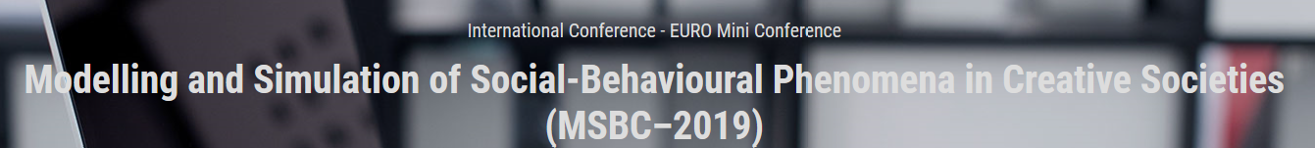


Agent-Based Simulation Model of the Relation Between Participation in Cultural Events and Social Capital Dynamics*
Darius Plikynas, Arūnas Miliauskas, Vytautas Dulskis, and Rimvydas Laužikas
Vilnius University, Institute of Data Science and Digital Technologies, Vilnius, Lithuania
Corresponding Email: darius.plikynas@mif.vu.lt
* This research received funding (No. P-MIP-17-368) from the Research Council of Lithuania.

Slide 2
Outlines
  Introduction: Motivation&Actuality
  Conceptual design
  Simulation model#1
  Results&Conclusions: model#1
  Simulation model#2 (presenter: Arūnas)
  Results&Conclusions: model#2
(MSBC–2019: Modelling and Simulation of Social-Behavioural Phenomena in Creative Societies
Notes:
Outcomes of this pilot study are potentially oriented for
cultural impact assessment to social capital,
rational strategic planning,
public cultural policy interventions,
use of public funds for general culture, and for encouragement of cultural industries and creativity.
The main conceptual idea of our research is to investigate the social impact of dynamical cultural processes in order to understand the impact of cultural events on the individual (agent or actor) and society.
Thus, in the course of cultural events, the added value of social capital is modelled, which generates the social impact of cultural processes.
And this social impact determines the processes of global convergence and local polarization in a society.
The conceptual model is empirically based on the analysis of the social impact of cultural processes and social capital measurements in UK, Lithuania and other countries.

Slide 3
Introduction: Motivation&Actuality (1)
Let us to remind that measurement of welfare has evolved to include six critical capital assets - physical, financial, intangible, human, natural, and the last one social. (Bourdieu, 1983; Putnam, 2000)
  James Coleman defined social capital functionally as "a variety of entities with two elements in common: they all consist of some aspect of social structure, and they facilitate certain actions of actors...within the structure. That is, social capital is anything that facilitates individual or collective action, generated by networks of relationships, reciprocity, trust, and social norms.‘ (Coleman, 1988)
  The current prevailing definition of social capital used in the OECD (Organisation for Economic Co-operation and Development) Well-Being of Nations report is: “networks together with shared norms, values and understandings that facilitate co-operation within or among groups” (OECD, 2001: p. 41).
  The OECD Statistics Directorate reviewed the Measurement of Social Capital. It was funded by the European Commission. Outcomes are three-fold:
  i) assessment of “social capital” concept in the research literature;
  ii) detailed metrics of how it has been measured in national and international surveys; and
  iii) identification of priority social capital application areas for statistical development.
(MSBC–2019: Modelling and Simulation of Social-Behavioural Phenomena in Creative Societies
Notes:
Please, let me share with you how I personally got involved into the social capital research area.
Believe me, it was not motivated by the utalitarian strive to find new ways to capitalize on one more form of the capital.
Nor it was a fashionable follow-up of some fashy buzz word, so called ‚social capital‘.
Honestly, last year my personal choice to get involved in this research area was motivated by the wish to get a better understanding of very fast social changes, which are taking place in our societies.
In my opinion never in the known mankind history social changes have been so fast, radical and unpredictable. Literarally we are overheating and it comes already in the form of climate change, social, and political tensions as well.
I assume that mostly technological and accumulated knowledge developments have made it happen.
With advancement of the information age we became globalized, transparent and open to so many changes that we barely understand where we are going as nations, regions or societies.
For instance, all forms of the classical capital have become intervoowen in so many ways, that nobody, not a single worldwide organization or goverments can grasp what is going on.
In economics, it is a well known fact that almost all macroeconomical models are faling to predict the future. In fact, already In 1994, Paul Ormerod in his famous book The Death of Economics has been arguing about unpredictability in the economy and the environment. Today situation got even worse. Our World became very complex. As all complex systems, it is in the state of bifurcations and emergence of possibly some new orders.
So, what is waiting for us in the near future?
Can we as scientist find new ways, models and methods to stand out these challenges?
These were my and believe some other researchers‘ motivations, which directed our search.
Namely, we strive to model impact of basic cultural events on social capital dynamics in a sense of clusterization, radicalization, globalization, and polarization.

Slide 4

Introduction: Motivation&Actuality (2)
The World Bank and other global institutions are looking beyond economic capital in their wealth metrics. What they found, that social capital is key to measuring the true wealth of nations.
Thus, for the numerical estimation of social capital global institutions mostly adapt OECD scheme, which uses four main ways in which the concept of “social capital” can be conceptualized and measured:
- personal relationships,
- social network support,
- civic engagement, and
- trust and cooperative norms.
(MSBC–2019: Modelling and Simulation of Social-Behavioural Phenomena in Creative Societies

Slide 5
Introduction: Motivation&Actuality (3)
Let us see an example of direct social utility stemming from the generelized trust
    Trust has proven hard to pin down, not least because it encompasses so many interrelated elements. Nerveless, we can most probably agree on some baseline observations:
    - Generalized trust enables social and economic cooperation. Most of these elements relate closely to generalized trust across a society and the functionality of key institutions.
    - Some argue that “social capital” can therefore be best understood as a means to creating trust.
  - We gain direct utility from living in a trustworthy society.
  - A key channel from social capital to economic outcomes is reduced transaction and monitoring costs, allowing the efficient allocation of resources in goods, labour and capital markets.
  - Society wastes resources when people distrust and are dishonest with each other.
  - The literature on repeated games and punishment shows why cooperation makes social sense when people expect to interact in the future.
(MSBC–2019: Modelling and Simulation of Social-Behavioural Phenomena in Creative Societies
Notes:
Last year Nobel Prize winner in economics Paul Romer pointed out that innovation which drives endogenous growth is not limited to technological capital and knowledge capital; it also applies to social norms and rules, governance, and policies, all of which drive total factor productivity.
He concludes, that any policies not built on strong foundations of trust and effective institutions will fail.

Slide 6
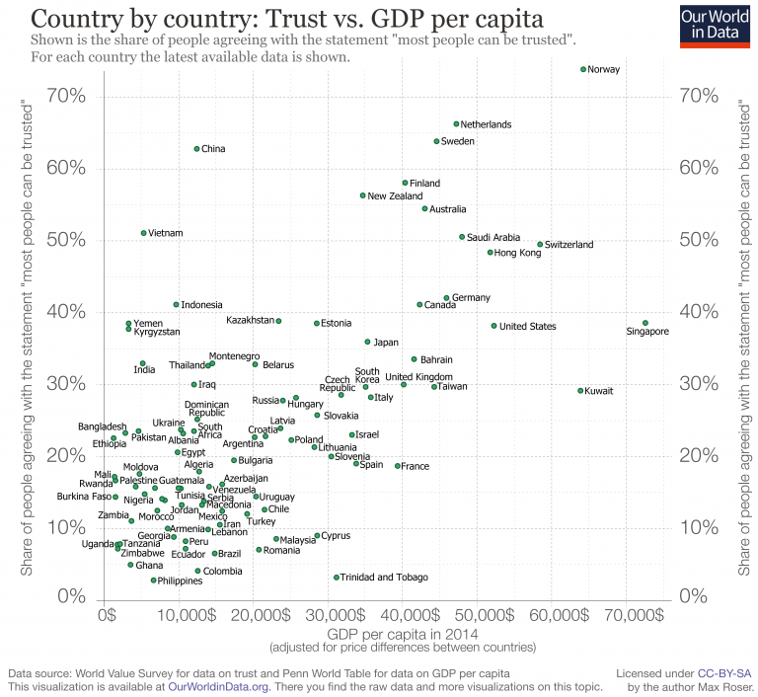
Introduction: Motivation&Actuality (4)
How do countries around
the world compare in terms of
interpersonal trust?
https://ourworldindata.org/trust
Fig. 1 Interpersonal trust levels as measured by the World Values Survey and European Values Study, and the European Social Survey (OECD – Eurostat)
(MSBC–2019: Modelling and Simulation of Social-Behavioural Phenomena in Creative Societies

Slide 7
Conceptual design (1)
After literature review, we figured out that there are no established ways of determining the level of cohesiveness or radicalization, but rather a collection of social network models that researchers have used over the decades to operationalize social capital (Woolcock&Narayan, 2000; Bourdieu, 2011; Perkins&Long, 2002).
  One of the dominant methods is Ronald Burt's constraint measure, which taps into the role of the strength of group cohesion (Burt, 2009). Another network-based model is network transitivity (Flynn et al., 2010), etc.
  Thus, in our study, following OECD approach, we also admit, that social capital (SC) is captured from embedded resources in trust, cooperation, relationships, networking, and civic engagement.
  In social networks, the level of cultural cohesion of a group affects its social capital and vice versa.
  We model and simulate basic stylized cultural events’ (popular culture, high culture, and sports) impact to social capital dynamics and distribution.
  Simulation strives to reveal basic conditions under which cohesion, clustering or radicalization behavioural patterns can emerge in the simulated society.
(MSBC–2019: Modelling and Simulation of Social-Behavioural Phenomena in Creative Societies

Slide 8
Conceptual design (4)
In the presented model, we employed CIDOC-CRM methodology, which provides a common and extensible semantic framework that any cultural information can be mapped to.
Agent-based simulation model is described using ODD standardized protocol. ODD stands for 'Overview, Design concepts and Details', which collectively comprise the three major categories of sections that ODD requires of a model description.
NetLogo MAS platform is used as a simulation environment. NetLogo is particularly well suited for modelling complex systems developing over time.
Our MAS follows some principles used in the seminal Axelrod agent-based physical neighbourhood interaction model. However, we expanded it for the long-range interaction approach, i.e. broadcasting of cultural events as well.
(MSBC–2019: Modelling and Simulation of Social-Behavioural Phenomena in Creative Societies

Slide 9
Conceptual design (5)
In the proposed model, agents themselves are creative.
Highly creative agents are able to generate multiple cultural events
Depending on the individual preferences, agents can participate or not in these events.
Agent’s A_{n} participation in the particular cultural event E_{s}(t) changes his social capital indices and individual social capital accordingly
(1)
Calculation of the social capital ∆C_{A}(t) for the whole population of agents A={A1, A2, …An}
(2)
(MSBC–2019: Modelling and Simulation of Social-Behavioural Phenomena in Creative Societies

Slide 10
Conceptual design (6)
(MSBC–2019: Modelling and Simulation of Social-Behavioural Phenomena in Creative Societies

Slide 11
Conceptual design (7)
Fig. 3. Conceptual model framework: sequence of cultural events, population of agents and social capital dynamics
(MSBC–2019: Modelling and Simulation of Social-Behavioural Phenomena in Creative Societies

Slide 12
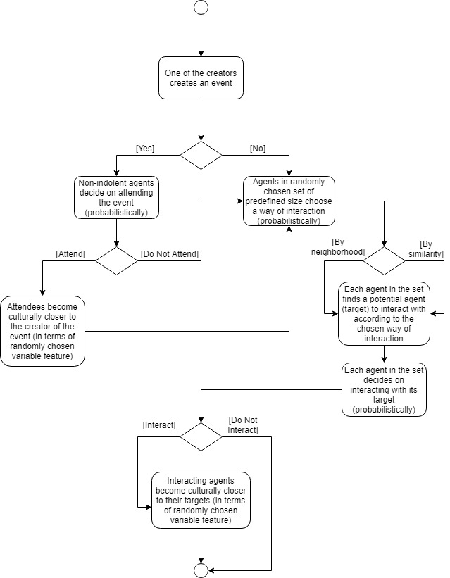
Simulation model#1 (1)
Fig. 4 Flow chart.
(MSBC–2019: Modelling and Simulation of Social-Behavioural Phenomena in Creative Societies

Slide 13
Simulation model#1 (2)
Fig. 5 NetLogo view of the model parameters and generated plots.
(MSBC–2019: Modelling and Simulation of Social-Behavioural Phenomena in Creative Societies

Slide 14
Simulation model#1 (3)
(MSBC–2019: Modelling and Simulation of Social-Behavioural Phenomena in Creative Societies

Slide 15
Simulation model#1 (4)
(MSBC–2019: Modelling and Simulation of Social-Behavioural Phenomena in Creative Societies

Slide 16
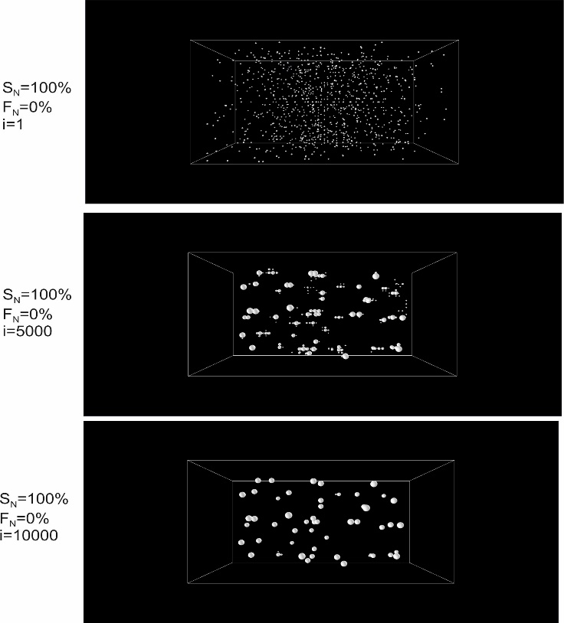
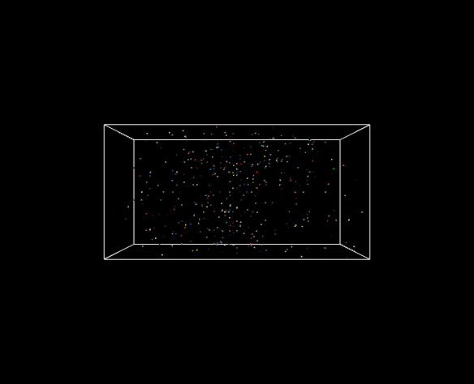
Results: Model#1 (1)
Fig. 6. Agents’ clustering after 0, 5000 and 10000 iterations, where interaction is based solely on the neighbourhood in the social capital dimensions (S_{n}=100%). The circle size indicates a relative number of agents in the cluster.
(MSBC–2019: Modelling and Simulation of Social-Behavioural Phenomena in Creative Societies

Slide 17
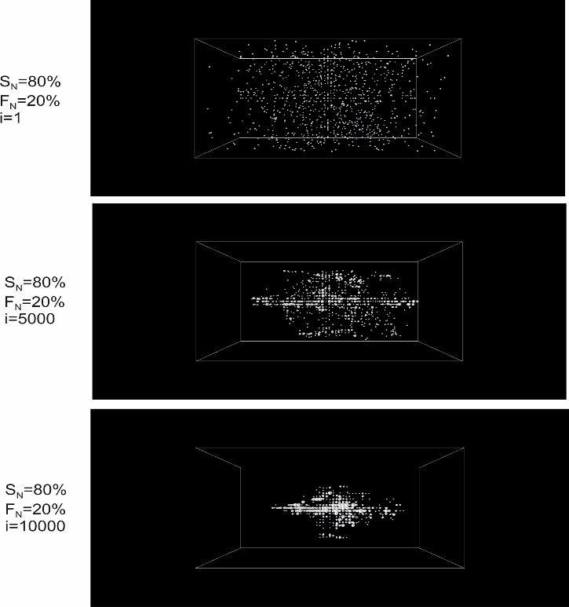
Results: Model#1 (2)
Fig. 7. Agents’ clustering after 0, 5000 and 10000 iterations, where S_{N}=80% of interactions are based on the neighbourhood in the social capital dimensions, and F_{N}=20% on the physical neighbourhood. The circle size indicates a relative number of agents in the cluster.
(MSBC–2019: Modelling and Simulation of Social-Behavioural Phenomena in Creative Societies

Slide 18
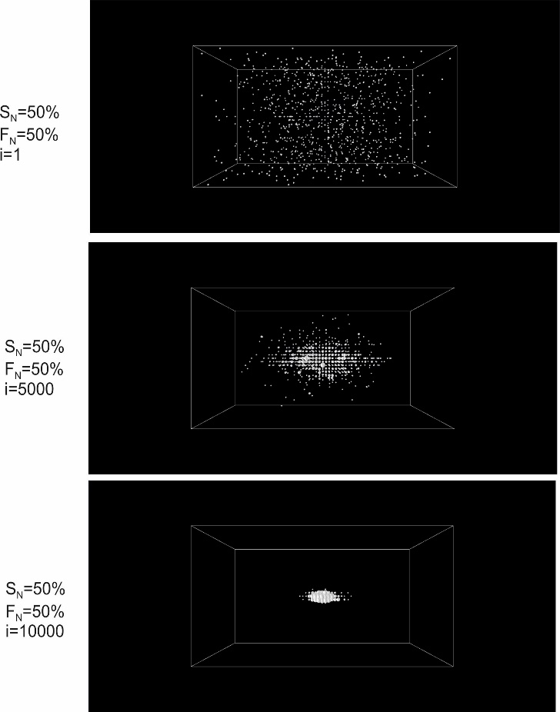
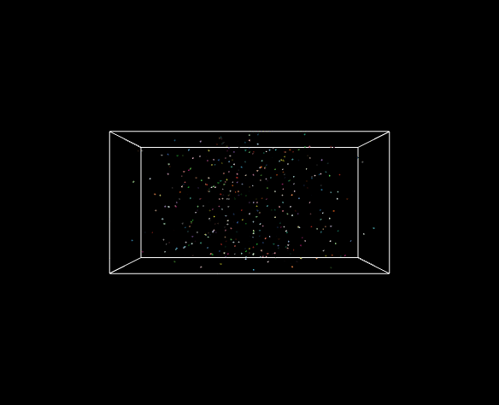
Results: Model#1 (3)
Fig. 8. Agents’ clustering after 0, 5000 and 10000 iterations, where interaction is 50% based on the neighbourhood in the social capital dimensions (S_{N}=50%) and 50% on the physical neighbourhood. The circle size indicates a relative number of agents in the cluster.
(MSBC–2019: Modelling and Simulation of Social-Behavioural Phenomena in Creative Societies

Slide 19
Conclusions: Model#1
Simulations revealed that interactions, based solely on the neighbourhood in the social capital dimensions, capture agents communities with the strong and long-term social relations that are prone to local polarization. When cultural similarity-based sharing of social capital is dominating, the society is prone to fragmentation (local polarization) as agents form distant social clusters. It means that the level of social capital inside of these social groups is high, but the social capital among clusters (social groups) is poor.
When the interaction with physical neighbors is rising, after some turbulent period a much stronger effect of convergence (globalization effect) is observed. Thus, despite that agents form a larger number of small social groups, the distances in terms of social capital dimensions tend to decrease. In this case, population is forming a global community, that has stronger external relations with other communities as well as higher number of external social interactions. Such communities are prone to convergence (globalization).
A similar to the physical neighborhood interaction, but much faster and stronger effect is taking place while simulating the social capital dynamics, when broadcasting of cultural events over the whole population is involved. Such simulation results confirm the well-known observations, that the impact of communication, mass media, and social networks is a major globalizing factor, which makes heterogeneous societies to converge, become culturally more similar.
(MSBC–2019: Modelling and Simulation of Social-Behavioural Phenomena in Creative Societies

Slide 20
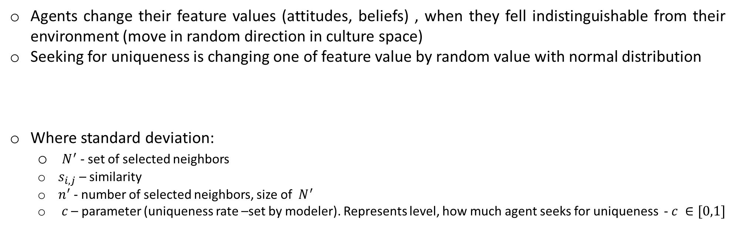
Model#2: Striving for uniqueness
Agents change their feature values (attitudes, beliefs) , when they fell indistinguishable from their environment (move in random direction in culture space)
Seeking for uniqueness is changing one of feature value by random value with normal distribution
Where standard deviation:
  $N^{′}$ - set of selected neighbors
  $s_{i,j}$ – similarity
  $n^{′}$ - number of selected neighbors, size of $N^{′}$
  $c$ – parameter (uniqueness rate –set by modeler). Represents level, how much agent seeks for uniqueness - $c ∈[0,1]$
(MSBC–2019: Modelling and Simulation of Social-Behavioural Phenomena in Creative Societies

Slide 21

Model#2: Social capital
Social capital is interpreted as weighted history of agent’s last interactions
where
  $r_{l}$ - agent’s $i$ interaction result before $j$ steps. 0 – unsuccessful, 1 – successful. $l=1$, denotes last interaction, $l=n$
  $w$ – history discount rate. $0≤w≤1$
  $n$ – agent’s history size
  ${scp}_{i} ∈[0;1]$
Higher social capital increases probability, that agents will interact (or agent will respond to the broadcasting event initiated by other agent)
  Where:
    $wc$ – selected by modeler, weight of social capital impact, $wc ∈\left[0,1\right]$
    $s_{i,j}$ - similarity, $s_{i,j}∈[0;1]$
(MSBC–2019: Modelling and Simulation of Social-Behavioural Phenomena in Creative Societies

Slide 22
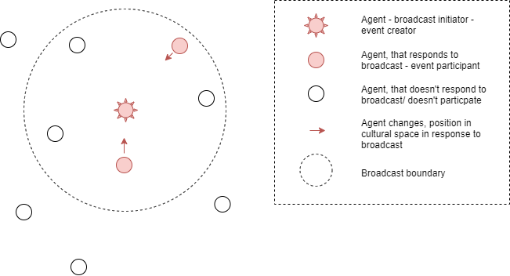
Model#2: Broadcast
Creative agents broadcast their state
Other agents, can respond to the broadcasted state. Distance from the event source is important.
Broadcasting has boundaries, which do not have effect beyond certain limits
(MSBC–2019: Modelling and Simulation of Social-Behavioural Phenomena in Creative Societies

Slide 23
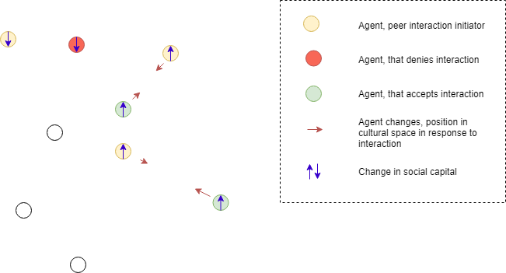
Model#2: Peer interaction
Agents choose a peer to interact (based on fixed neighborhood or similarity)
Successful interaction increases social capital. Agents move to each other in cultural space
Unsuccessful interaction decreases social capital
(MSBC–2019: Modelling and Simulation of Social-Behavioural Phenomena in Creative Societies

Slide 24
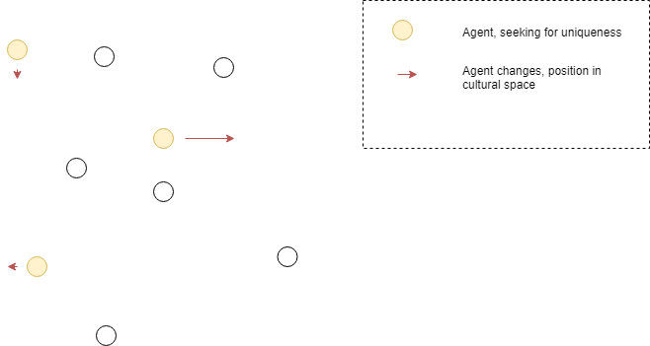
Model#2: Striving to uniqueness
In each iteration, randomly selected agents change only one cultural feature. It is based on similarity with a chosen neighbors.
(MSBC–2019: Modelling and Simulation of Social-Behavioural Phenomena in Creative Societies

Slide 25
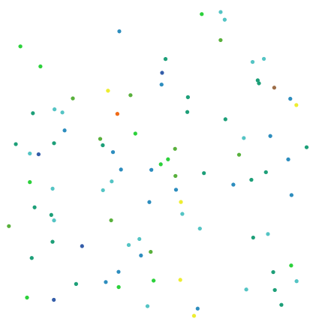
Model#2: Some results
Striving for uniqueness – additional force, that pushes toward mono culture. It breaks strict boundaries, that occur in Axelrod’s model
However in resulting monoculture has heterogeneity and changes over time.
(MSBC–2019: Modelling and Simulation of Social-Behavioural Phenomena in Creative Societies

Slide 26
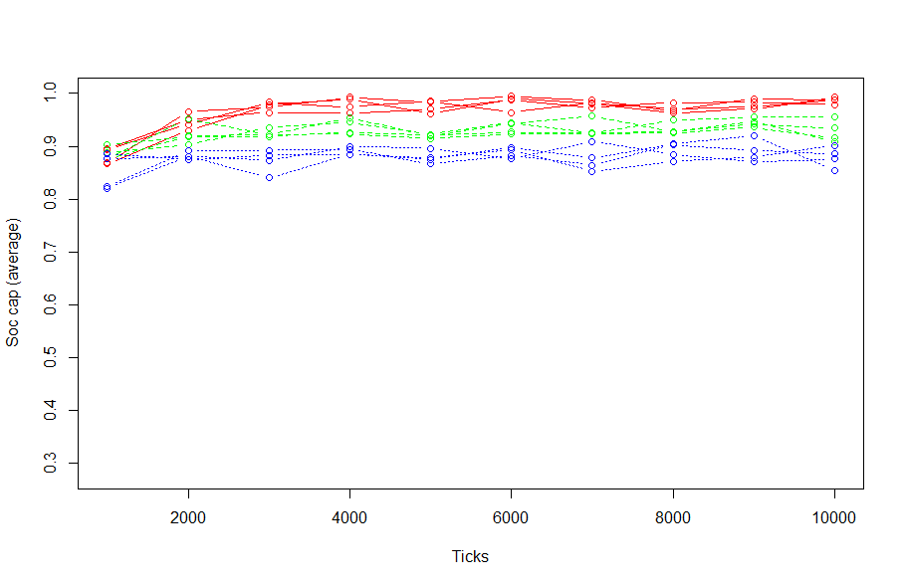
Model#2: Some results
Social capital final grows as world converges to monoculture. Limit of social capital is set by uniqueness rate
(MSBC–2019: Modelling and Simulation of Social-Behavioural Phenomena in Creative Societies

Slide 27
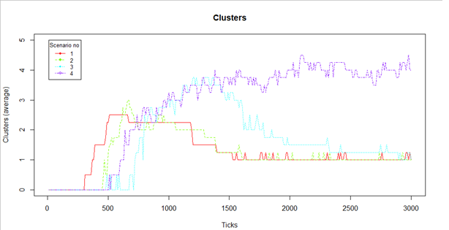
Model#2: Some results
Interaction based on neighborhood vs similarity in cultural space
Scenarios based on similar-over-neighborhood value:
  0 interactions based on fixed neighborhood
  0.4 - 60% interactions in fixed neighborhood, 40% with similar agents in cultural space
  0.7 - 70% in fixed neighborhood, 30% with similar agents
  1 – only with similar agents
Clusters calculated with dbscan
algorithm (eps = 7, MinPts = 15)
(MSBC–2019: Modelling and Simulation of Social-Behavioural Phenomena in Creative Societies

Slide 28
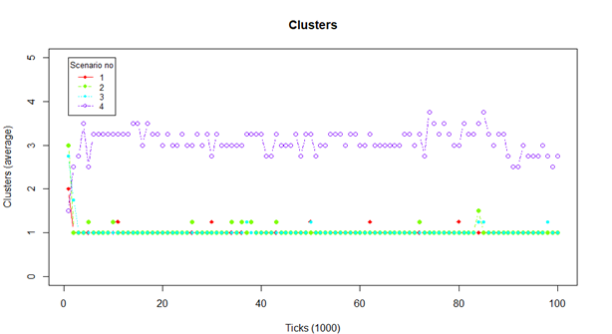
Model#2: Some results
(MSBC–2019: Modelling and Simulation of Social-Behavioural Phenomena in Creative Societies

Slide 29
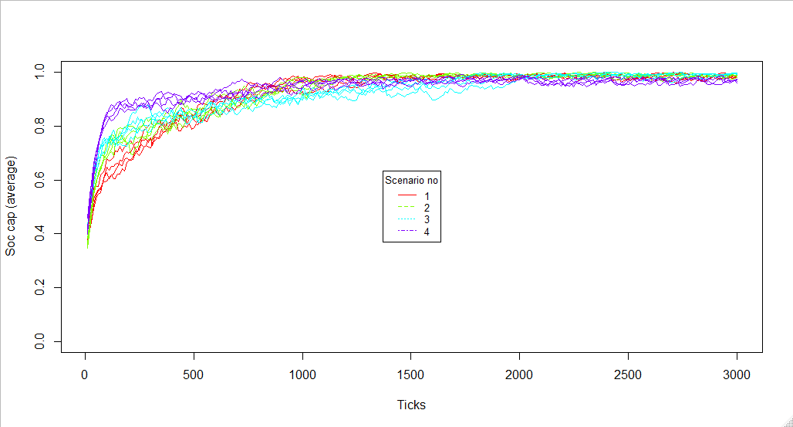
Model#2: Some results
Interaction based on neighborhood vs similarity in cultural space effect on social capital
Scenarios based on similar-over-neighborhood value:
  0 interactions based on fixed neighborhood
  0.4 - 60% interactions in fixed neighborhood, 40% with similar agents in cultural space
  0.7 - 70% in fixed neighborhood, 30% with similar agents
  1 – only with similar agents
(MSBC–2019: Modelling and Simulation of Social-Behavioural Phenomena in Creative Societies

Slide 30
Model#2: Conclusions 2
Striving for uniqueness is “wall breaker” between disparate clusters.
Social capital final values will increase until some limit, which depend on uniqueness rate convergence forces: peer interaction and broadcast.
Broadcast in cluster creates higher density clusters, than interaction solely on peer interaction and higher social capital
Broadcast with limited field is additional force for local polarization. The bigger preference toward interaction with similar agents, in peer interaction, the longer clusters prevail. Broadcast prolongs (when agent strive for uniqueness) world state with multiple disparate clusters.
(MSBC–2019: Modelling and Simulation of Social-Behavioural Phenomena in Creative Societies

